Slide 1
Planning and Control of Trades
In Orbit the Tool, trade planning is easy and necessary. Because of this, planning parameters are made explicit using by using Parameters =Orbit Commands.
These are therefore simple to understand and use, and with practice a permanent trading edge.
To understand the basis for such parameters (why and how they work), a User must complete and understand the set of Orbit Books. It is from the knowledge of Orbit Logic that we will gain confidence.
The reason for 2 is therefore simple. the parameters follow a logic and the books explain all one needs to know about that since in fact the commands used to analyse, read, interpret and trade markets is justified in the LOGIC----> Orbit Logic.
Best wishes,
S
PS: Orbit the Tool is not “technical” trading it is chaotic trading or Deterministic trading. Do not mix them up as they are based on different premise 300 million light years apart (est.) So for experienced and profitable “technical” traders you want to decide to learn to Deterministic Trading or simply keep to your “technical” know how. In mathematics “technical” trading falls under stochastic models of the market, Which are very different from a Deterministic. So do not waste your time choose one and stick to it. Stochastic Models are speculative (guesses – sometimes they work, other times (most of the time), they do not). A deterministic model works all the time. Please see planning parameters for deterministic trading below.

Slide 2
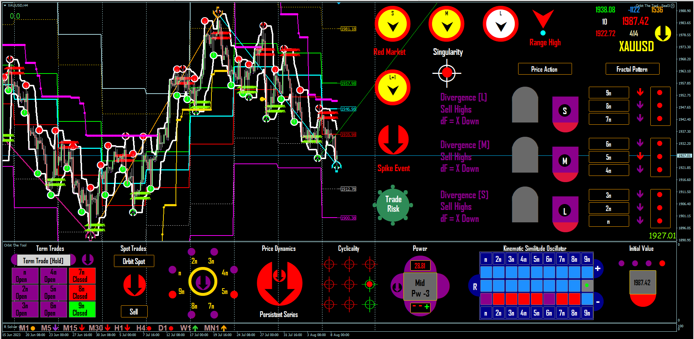
δ Cyclicality + δ TT = {Spot Trend} = {Diagonal} (Phaselock)
Pullback = δ Fluctuant On
Strategy = Sell Highs/Buy Lows or Hold (BC)
Stop > B (Risk-Free Space = BC)
TP = C (FLE)
The Space Plan () For a new week.
BC
B
Space AB
New Week
Space BC
C
A
δ Cyclicality + δ TT = {Spot Trend} = {Diagonal} (Phaselock)
Pullback = δ Fluctuant On
Strategy = Buy Lows/Sell Highs or Hold (AB)
Stop < A (Risk- Free Space = AB)
TP = B (FLE)
AB
Active Down (Trade/Hold)

Slide 3
Referencing the Orbit Logic – Page 12
Page 12 says on command Spot Trend Command {δ Cyclicality + δ TT = {Spot Trend} = {Diagonal} (Phaselock)}
When Space AB is phaselocked then, A ---> B Correct 100/100 Times
That the User has 2 control signals in space AB (Commands 1 and 2)
That the User may deploy any of the elements in 3 as strategy over this space.
That the User sets Stop < A (Risk-Free Space = AB)
That the User TP’s all trades cyclic trend side = B (FLE)
Page 12 says on command Spot Trend Command {δ Cyclicality + δ TT = {Spot Trend} = {Diagonal} (Phaselock)}
When Space BC is phaselocked then, B ---> C Correct 100/100 Times
That the User has 2 control signals in space BC (Commands 1 and 2)
That the User may deploy any of the elements in 3 as strategy over this space.
That the User sets Stop > B (Risk- Free Space = BC)
That the User TP’s all trades cyclic trend side = C (FLE)

Slide 4
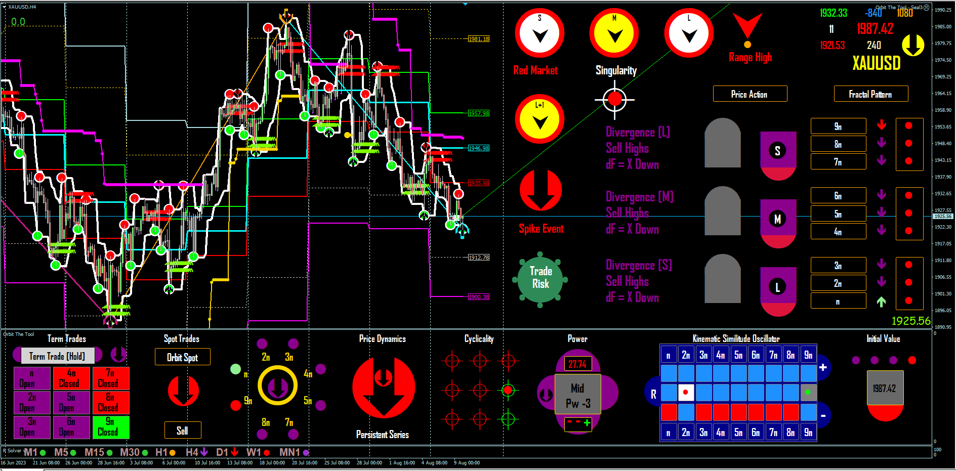
Type of trade = Scalp
Return $42.50 Net of charges
Example Trade 1
BC
Today
Strip Statement

Slide 5
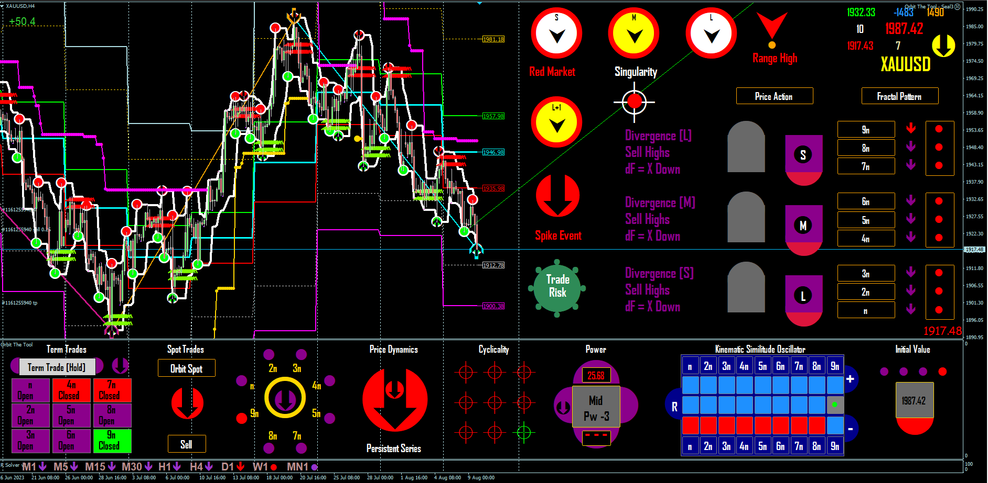
Type of trade = Scalp
Return $130.50 Net of charges
Example Trade 2
BC
Today
Strip Statement

Slide 6
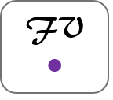
2023

