Slide 1
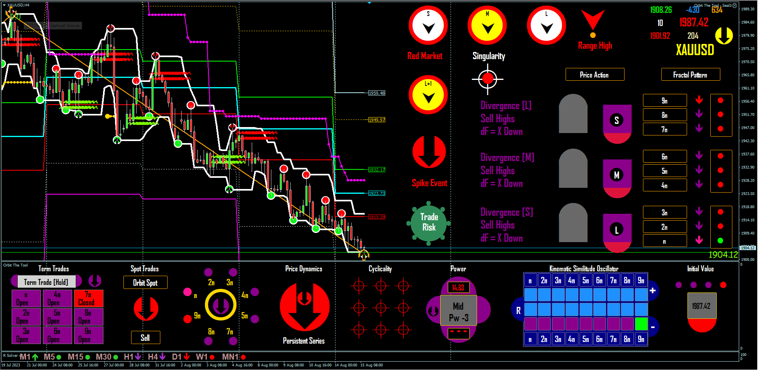
Retail Strategy: One Side Seeding
Seed Points
Seed Crown and each blackhead Pinpoints
Hold to Cash Point (a low region in space)
Cash Entry Set @ Cash point
Risk – Free Space
Cash Point
Area
Market intent on opening
this Closed space?
Guaranteed by “Spot Trend”
Command ---> See History

