Slide 1
Trading Report plus Step by Step Logic Followed
Today was not a good day for me. I was only able to take just $172 from the market. I am not a trader and as a chaotist I was really busy today and so was too distracted to trade and late to actually enter trades and therefore I chose to scalp the market twice trading the H4 Market window for simplicity (pivots translate over the longest range intraday, so, best for all trades including scalps in my humble opinion).
However, sharing the trades and you reviewing them will show how simple and safe Orbit is to trade. It will also show how well structured and professional the trading can get for anyone including newbies.
They say I talk too much in writing too long so will keep this simple and graphical.
So please go through slide by slide and you will see a) How I plan my trades for the week b) How I use page 12 as a reference to do so c) How page 12 provides all the information I need to execute the plan easily and without risk.
In addition, make comparisons for example, the ease and efficacy of trading Orbit (just 2 control signals to employ (no sweat)). Also the ability to plan at all in a transparent and effective way, and though I won very little the fact remains I had no time but for the time I had it was Ok given the ease and safety.
Also looking at all the facts presented judge whether or not this is a sustainable harvesting strategy for the week and others ahead? In any case it is very convenient involving no stress whatsoever or wondering the state of the market, or where to take trades, when to do so, etc. There are no “scarecrows” just LOGIC----> Orbit Logic.
Best wishes,
(_-_)

Slide 2
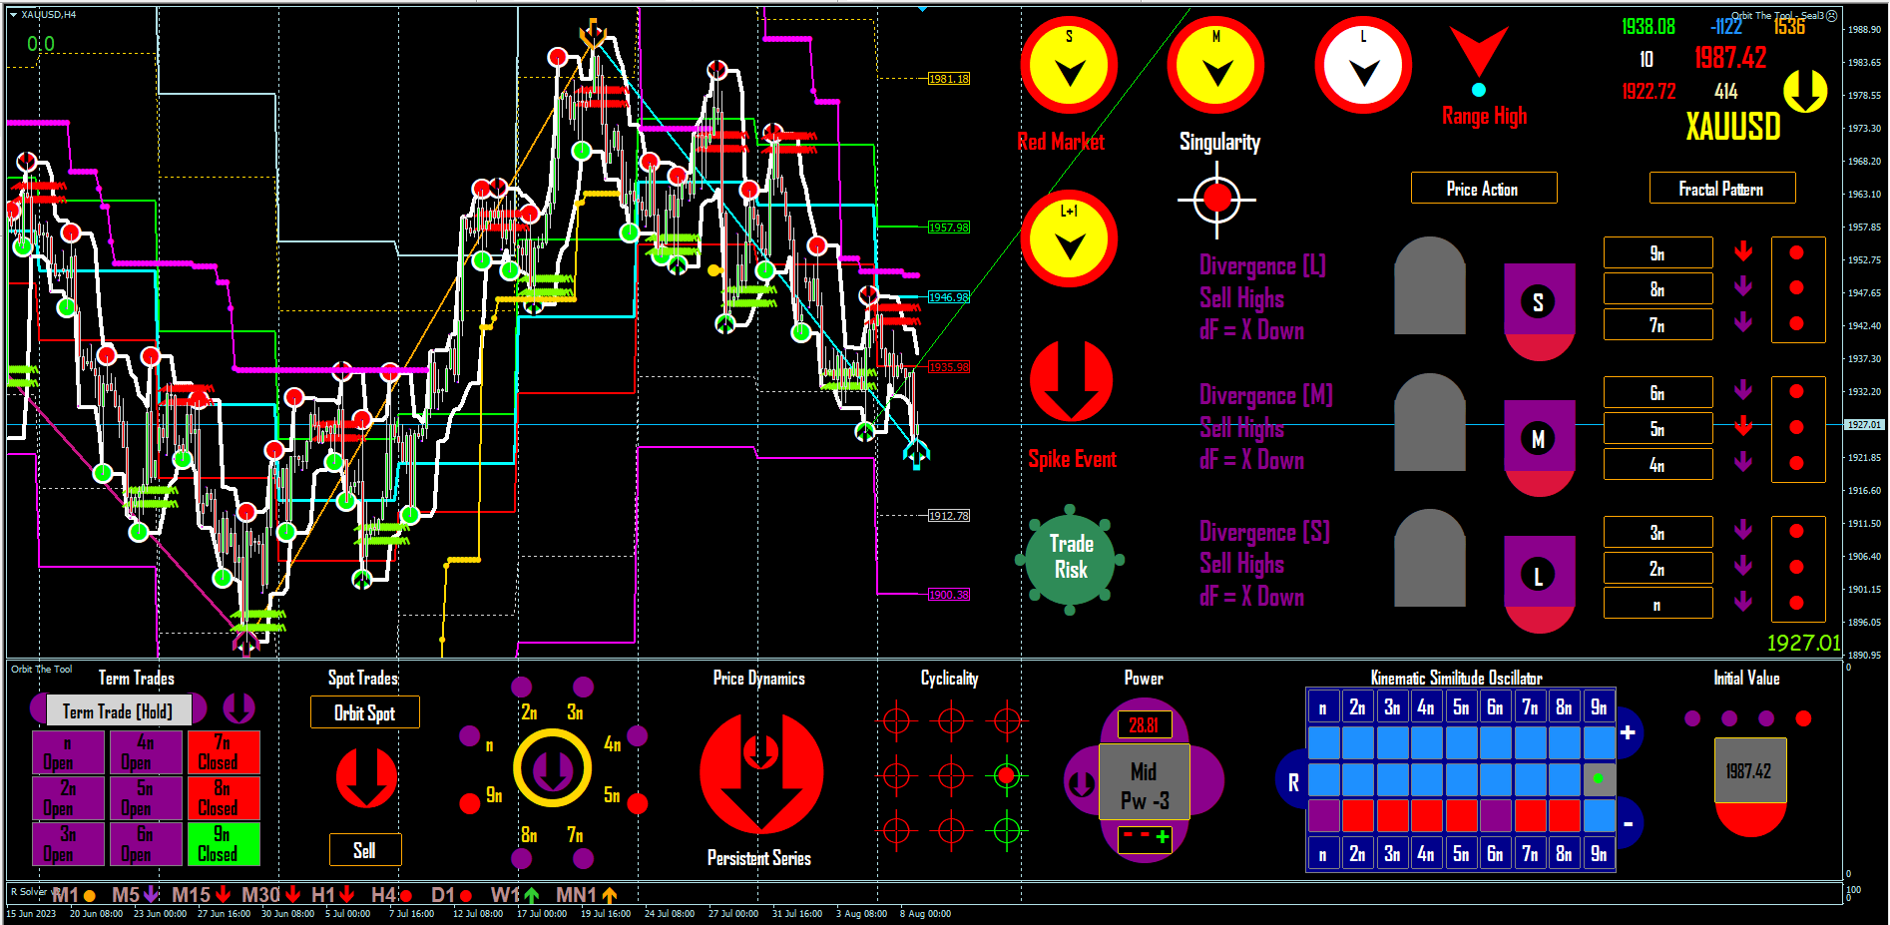
δ Cyclicality + δ Inverse On = Diagonal (Phaselock)
Pullback = δ Fluctuant On
Strategy = Sell Highs/Buy Lows or Hold (BC)
Stop > B (Risk-Free Space < B)
TP = C (FLE)
The Space Plan () For the new week.
B
Space AB
New Week
Space BC
C
A
δ Cyclicality + δ Inverse On = Diagonal (Phaselock)
Pullback = δ Fluctuant On
Strategy = Buy Lows/Sell Highs or Hold (AB)
Stop < A (Risk-Free Space > A)
TP = B (FLE)
AB
Active Down (Trade/Hold)

Slide 3
Referencing the Orbit Logic – Page 12
Page 12 says on command 1 space AB is phaselocked and, A ---> B 100/100 Times
That the User has 2 control signals in space AB (Commands 1 and 2)
That the User may deploy either elements in 3 as strategy over this space.
That the User sets Stop < A (Risk-Free Space > B)
That the User TP’s all trades cyclic trend side = B (FLE)
Page 12 says on command 1 space BC is phaselocked and, B ---> C 100/100 Times
That the User has 2 control signals in space BC (Commands 1 and 2)
That the User may deploy either elements in 3 as strategy over this space.
That the User sets Stop > B (Risk-Free Space > B)
That the User TP’s all trades cyclic trend side = C (FLE)

Slide 4
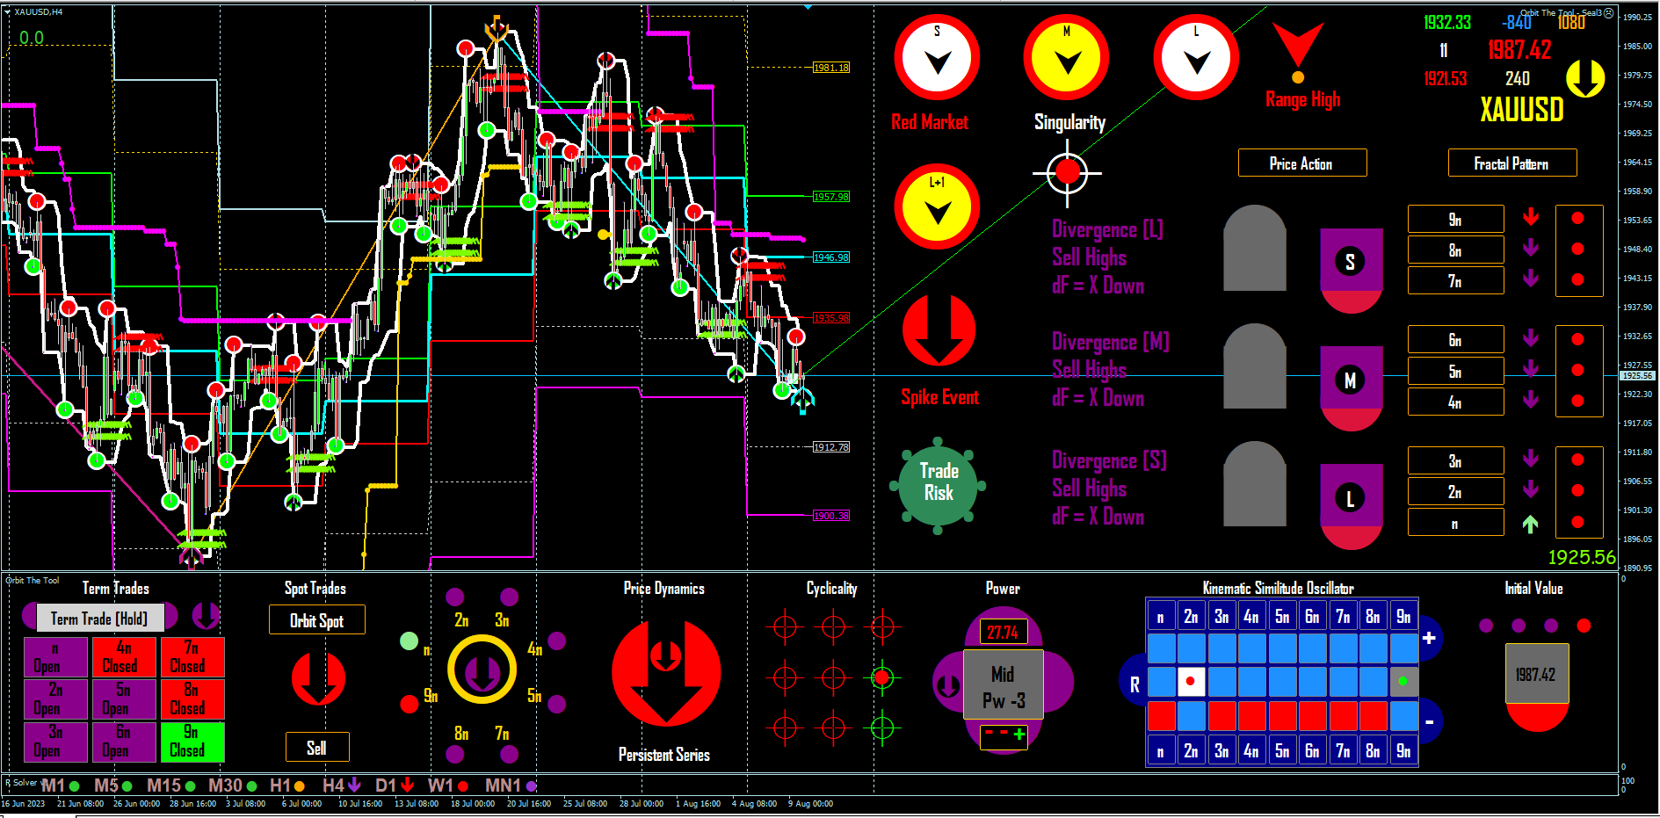
Type of trade = Scalp
Return $42.50 Net of charges
Trade 1
BC
Today
Strip Statement

Slide 5
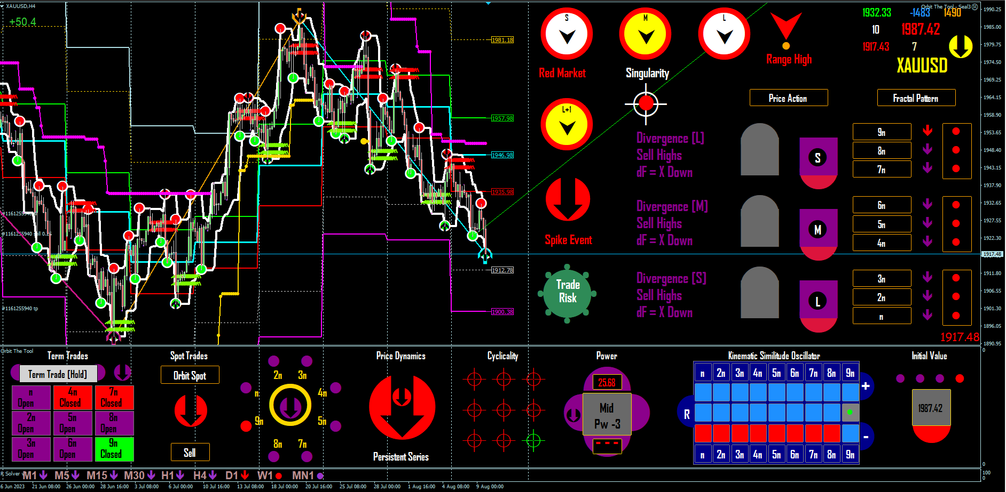
Type of trade = Scalp
Return $130.50 Net of charges
Trade 2
BC
Today
Strip Statement

