Slide 1
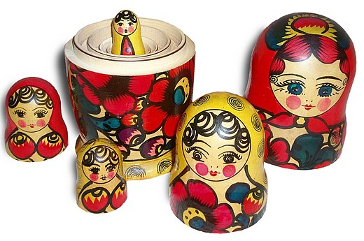
The Market is a Nested System of Pivots, and to make the most money per trade, we use a “Trick.”
The Market is like a Russian Doll only far more complex. Because pivots are nested one inside another to infinity, and are all the same point at a time. So you can trade the market from any “Time Frame,” because the trade/entry points or Semaphores Match exactly.
Nested
Important to learn to use the various important “tools” that make up Orbit the Tool which when properly understood influence and affect the outcomes allowed by the tool. The Match Matrix in the ProPlay book is one such tool to understand well so that in Orbit you are not just taking trades and scalps but calculated trades on which the trader predefines his/her objectives ever before entering a trade and also informs on dynamic trade management decisions.
Russian Doll
On
M1 = | Truncation (M1) = | H1 = | Pip Range = | H4 (Base) = | Action Space =
G (4) | G (4) | W (1) | Scalp | 0 | FLE
M (5) | M (5) | Y (2) | Super Scalp | W (1) | FLE
M (5) | G (4) | A (3) | ID Trade | Y(2) | FLE/Breakout
M (5) | G (4) | G (4) | ID Trade | A (3) | Space
M(5) | G (4) | M (5) | S Trade | G (4) | Space
M(5) | M (5) | M (5) | P Trade | M (5) | Space
①
②
③
④
⑤
⑥
Matches
Profit = $$
Profit = $$$$$$
Match Matrix

