Slide 1
A MUST READ and UNDERSTAND:
The Orbit Arrow and other Entry Options plus Developing your Personal “Trading System” Within Orbit the Tool

Slide 2
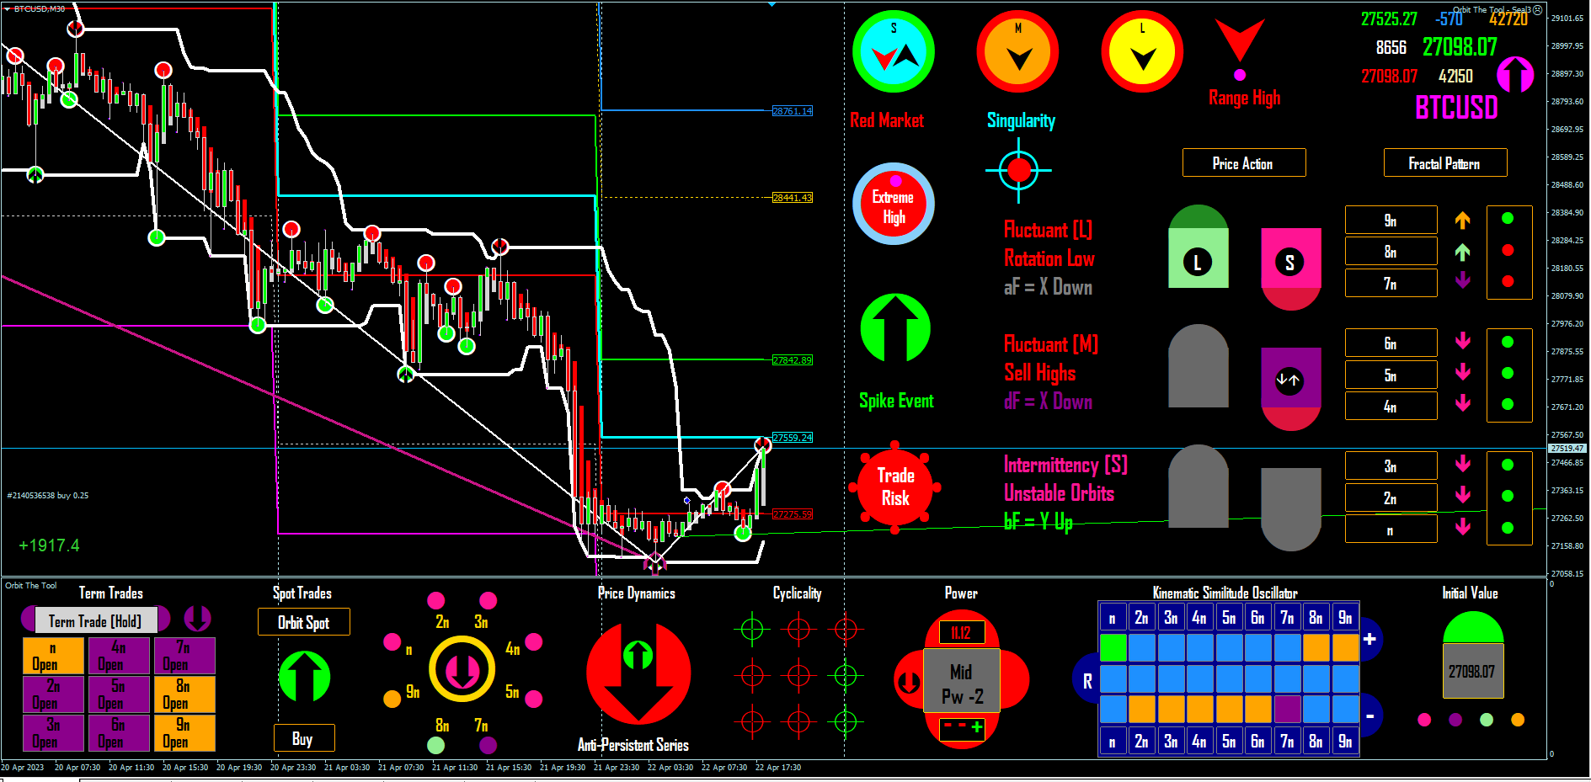
Early Entries
Here I am making money fast and easy but look at the icons – what gives me the audacity?
When you know the background you can be creative and flexible about your style without labouring the “rules.”
You have to explore – trial and error using the tool to find yourself and your style on the tool.
What I say is what I know but that does not mean you cannot know beyond me, you are a TRADER explore.
Adventure is not just an English word it is a mindset.

Slide 3
What is the Promise of Orbit the Tool?
What is the promise of Orbit the Tool? The promise of Orbit the Tool is to time and follow the trajectory or orbit of price from a current Low Stop to the next High Stop available in the market. And to do the same for the current High Stop to the next Low Stop. Further, to do so accurately and therefore 100/100 times. This is why it is called an Oscillator Model of Market Movement. Orbit will deliver this promise for any traded market.
What is the best sense to understand this loop tracking function? The best sense is this: When the n – 6n partitions are arrayed over the low extremum of the KSO (i.e. KSO = -), on change to buy colours the n – 6n partitions will gravitate through KSO = R, to the highest price available in the market (i.e. KSO = +). Similarly, and from a high price, to loop to the lowest price available in the market, on a change to sell colours the same n – 6n partitions will again loop back through KSO = R to the low extremum.
The partitions 7n – 9n are senior partitions and when they join the intraday partitions in this loop movements they extend the range in direction of the market objective. This has the effect of intensify the aperiodicity of the intraday cycle so that it becomes recursive e.g. a) n-6n fall/rise to KSO = R, then return to the previous extremum or b) staying arrayed in the extremum change to buy/sell then reverse to the motive colour of the extremum without reaching KSO – R. Therefore, note that reaching an extremum does not imply automatic reversal – usually and depending on market conditions price intensifies in direction. Only the change in colours communicates the specific behaviours expected upon such changes. However, the trader is ONLY expected to track the changes in the KSO and NOT to act on them. For trade action we have specific triggers but the above gives a sense of what Orbit the Tool is doing at all times i.e. tracking price loops through space.

Slide 4
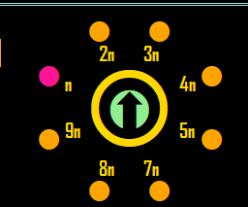
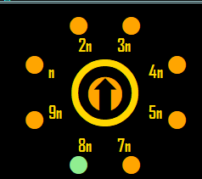
What in Orbit the Tool most robustly indicates current loop direction?
The Orbit Arrow also called the Secret Arrow does.
Weak Up Strong Up
The Orbit Arrow tells points the current trajectory.
On change from up to down or down to up we have firm information of where the market is headed.
However, the actual path of price follows a Strange @ttractor. The middle section of this construct contains a “saddle,” i.e. one or more depending on market conditions especially range extensions.
This causes a certain instability in the pointing of the Orbit arrow as price is moving between pivots and not in a straight line. So the trader must keep in mind one thing. The arrow maintains the direction of the last largest pivot in range and will not change that direction until an equal opposite sized pivot is reached no matter what, e.g. a 6n 2(Y) low ----> 6n 2 (Y) high. Fluctuations between 6n 1 (W) will NOT change the initial trajectory no matter what. That is the way to read the Orbit Arrow.
To help the trader appreciate this and within the model, arrow middle-colour waxes and wanes in line with the statement in (4) above. The trader MUST maintain that sense.
Most important, at amplitude arrow will not change automatically and may lag the turn by up to 8 hours. However on turn will still travel a highly profitable range, so a question of patience and conditions.

Slide 5
What are the Key takeaways from the first 2 slides?
The first 2 slides try to assure you that Orbit the Tool keeps its promise always but that however, the orbit or trajectory of price is highly nuanced and requires that a) The trader understands that the system (market), is deterministic b) Which means when you enter a trade at low once the Orbit Arrow turns price must reach a next Semaphore at high of equal weight, X – Y and vice versa c) without this understanding you will get confused as a trader and jump or lose trades. But with the understanding Orbit will always guide you correctly.
For most traders (including the author), one needs a sense of independence and to wait for and follow primary cues like the Orbit Arrow is not flexible enough to enable one express his trading. So without changing the dictates of the space (market space), as the tool reads it, but to allow discretion and flexibility I will give you the complete sequence that informs Orbit Arrow turns (which follows a strict principle and turns at the maximum safe or least risk entry point), and I will give these steps to reflect the before, during and after an Orbit Arrow turn.
Why? What is the intention? Well the idea is to give you the trader or Orbit user all the indications and events that will enable each trader elect his or her own style and or define a “trading system” with which the trader feels comfortable. Also by learning the steps from observation use your experience to respond to emergent opportunities and take certain advantages that you may see and know but which the inventor may not see or know about the market from your personal and unique perspective. Please study the list well and think about the list and what it means to your trading only keeping in mind the principle that X = Y and Y – X always and NO MATTER WHAT. That is the key.

Slide 6
What is the complete sequence to the safest entry?
Amplitude @ Scale = Semaphore = 5n ≥ 2(Y) matched by Semaphore = 6n ≥ 1(W) (exit old trade)
On Amplitude n flow cut indicates turn and in (e.g. Gold which is what I trade), is good for up to 1000 points id before screenface signal indications.
Followed by Fractal Pattern change in direction (fluctuant or dot only), this is early entry
Followed by Range arrow change which is generally a late entry compared to the other 2 above and
Followed by KSO buy/sell colour change (which actually confirms that price will loop from one extremum to the other.
This is followed by Cyclicality coherence and finally,
Orbit Arrow Change (which is why it is literally the safest point of entry and takes time but note that at scale the target ahead is so significant that of course it is also highly profitable).
So what is the risk in entry for 1 – 6? In theory if amplitude = true as defined above, the risk is zero. However experience shows that a) if any or all of 7n-9n have joined the intraday n-6n in the KSO array the situation can be pretty fluid which means that in an affine structure such as market fractals pullbacks can be extremely shallow and signals do not differ for a reversal and a pullback. Therefore, it becomes important to a) scope the market ahead of 6n b) check the pattern to the point of turn. What I really mean is that translation speeds change such that on any of those cues 1 – 6, 5n or H1 can for instance pivot 2(Y) – 2(Y) on a single bar (which validly completes a cycle) and sleeve up or down in a matter of minutes to resume direction – so without any wrong cues by Orbit the effect is a bull kick or bear claw in the face and not nice at all. In such cases however with availability do – renter direction without further thought. So there, I use this knowledge to vary my trading and so can anyone. I hope all of the above is not a waste of anyone’s time.

Slide 7
End Notes:
In choosing any of the entry options you are changing your risk reward ratio.
Most allow you a pip/point distance to stop loss that is pretty small while still highly dependable.
Therefore stick to your entry and do not fret (cut your trade because it looks like failing), after your entry your. Experience with any of them should report very high consistency of success.
Important to trial this tool one way or the other for a little while – e.g. 2 months to begin to draw firm conclusions.
Nothing compensates for in use experience in wishing to master a new concept and nothing is so simple and direct that trial and error will not be a part of the learning experience
Fractal Visions 2023

