Slide 1
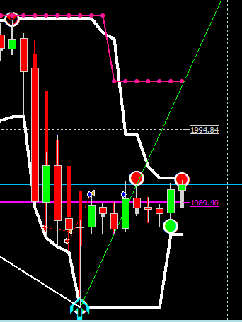
There Are No RULES Just Natural Laws Of Behaviour
To Follow
Orbit the Tool is NOT about indicators and what they tell you. It is about the underpinning concepts in the mathematics of price movement. The first thing therefore to learn is the concepts. [1] Chaos is the repeated folding and stretching of the space to which price maps. So the first question in your mind always is where is price and what is it doing? If it is folding as in this live screenshot where is it pointing? The Semaphores clearly provide this information. Price is pointed north because the Crown is at a Low. Price is folding so you enter a buy in folding space and wait for the move to follow.
But what about the “trend” and what if news or some “fundamental” event, or other “scarecrow” changes price direction? Price does not trend. Chaos does not admit random events into its future states and so [3] price MUST complete its course according to a pattern or path known as the market Strange Attractor. See the full orbit or path for this buy entry on the last slide. Master this path or pattern in your mind and when you enter a buy or sell know that this is how the entry will complete. This is your expected result always. Again simple!
[2] So how do you know price will move in your direction for sure? Or that it is directed enough in folding range to translate your buy to the highest exit available? You know this from the concept known as a bijection with Inverse On. A low is called to a high and high to a low and the Semaphore Crown Low tells you Inverse is On. Simple!

Slide 2
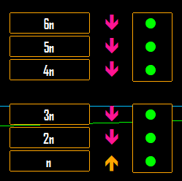
One or All of 3
Note: For UP entry this cue is sufficient on its own and it is also the earliest
of 3 options – all equally valid as standalone or combination CUES.
Fluctuant Only Ignore Arrows or “trend” part
Where is price?
Folding or Stretching?
If in folding range (MRI), where is it pointing?
Check if Crown at low? Check location of folding on Strange Attractor.
On New crown at high is that TP? Check TF + 1...
Fractal Pattern
id Fluctuant +VE (●n – 6n)
= Inverse On
Enter buy
Set Stop to Semaphore Low
Track progress by pattern (Strange Attractor)
The Reverse is True for Down Entry

Slide 3
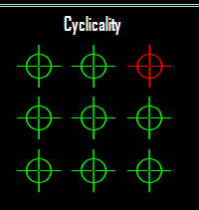
One or All of 3
Note: For UP entry this cue is sufficient on its own or in cobination with the other 2
options – all equally valid as standalone or combination CUES.
Where is price?
Folding or Stretching?
If in folding range (MRI), where is it pointing?
Check if Crown is at low? Check location of folding on Strange Attractor.
On New crown at high is that TP? Check TF + 1...
Cyclicality
id Cyclicality +VE (●n – 6n)
= Inverse On
Enter buy
Set Stop to Semaphore Low
Track progress by pattern (Strange Attractor)
The Reverse is True for Down Entry

Slide 4
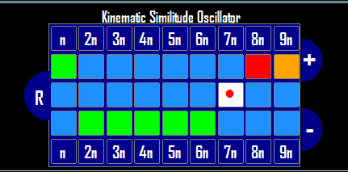
One or All of 3
Note: For UP entry this cue is sufficient on its own or in cobination with other 2
options – all equally valid as standalone or combination CUES.
Where is price?
Folding or Stretching?
If in folding range (MRI), where is it pointing?
Check if Crown is at low? Check location of folding on Strange Attractor.
On New crown at high is that TP? Check TF + 1...
KSO
id KSO +VE@ KSO (-) (●n – 6n)
= Inverse On
Enter buy
Set Stop to Semaphore Low
Track progress by pattern (Strange Attractor)
The Reverse is True for Down Entry

Slide 5
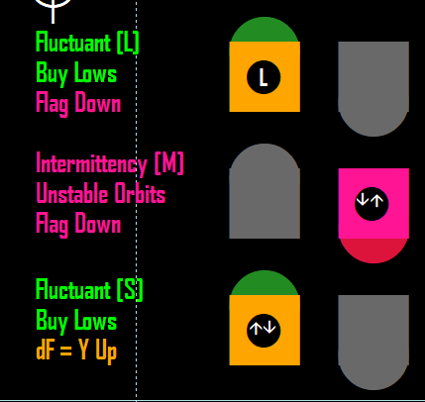
The Screenface
The Screenface provides incredibly useful context specific information for any ongoing evolution.
Use it. Learn what it is telling you by learning to read it in context, e.g. see S as highlighted for information at some decision point.
Change is from S – L – L+1.
The future depends on what happens now so the future adjusts to the present not the other way around.

Slide 6
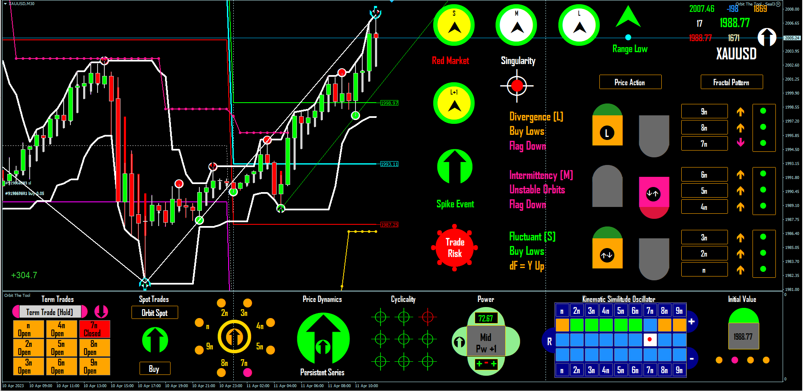
The Strange Attractor
Practice this i) find attractors across different TF’s ii) learn to identify the parts in each iii) Think what will be my action in the different parts?
Price is either Folding or Stretching, and all happen on the attractor. The attractor combined with the MRI defines trading space and type of action. Makes it easy to know where you are and what to do, when. It is a dynamical concept – it lives in your mind and also charts from where you project trajectory and the actions to take.
Note that at the end of e.g., an M30 window attractor check H1 window to see if termini or continuation.
It is a key trading tool and that for the market discovered by me. Use it to profit.

