Slide 1
This is what you are trading Up and Down moves with Inverse On
Inverse On
n
2n
3n
4n
5n
6n
7n
8n
9n
+
R
-
Range Low
n
2n
3n
4n
5n
6n
7n
8n
9n
Up move
Down move
n
2n
3n
4n
5n
6n
7n
8n
9n
Range High
+
R
-
n
2n
3n
4n
5n
6n
7n
8n
9n
Inverse On

Slide 2
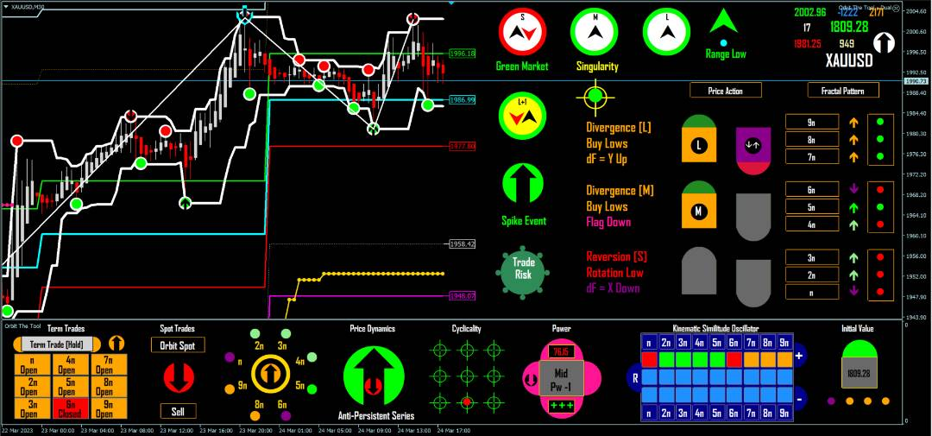
A TOP
A
When a Top Crown is seen in an uprising amplitude high is suggested.
The market is driven by a mathematical function with continuous inverse on, and that is to say a homeomorphic bijection with inverse on. So price does not begin to fall randomly at crest, instead;
The function takes in a) the fact of a crest as [input] to which it b) applies an operation, i.e. repeated [folding] in order to define c) the output [stretching] and in this case in the downward direction.
We show in the slides that follow the Process by which Orbit the Tool communicates and therefore guides a trader to trade the inflection shown down. This process is also true for a rise and in all cases Orbit is correct 100/100 times in reading chaotic space accurately.

Slide 3
FLE
B
6
7
1
3
4
2
5
From the function described in the slide before we see the system applying the folding operation.
The screenface is changing back and forth because of intermittency or sensitivity to initial conditions. But this does not negate the fact of what will follow next. A high crown in folding offers up and down short-term trades because we are in Finite Loop Equilibrium (FLE).
The screenface will change with increasing firmness from left to right and the signs to watch for in the partitions indicated are marked 1 – 6 in our screenshot.
But in FLE the orbits are unstable so you can only be sure of point to point (semaphore to semaphore) trades.

Slide 4
Induction
C
6
7
1
3
4
2
5
The changes in B from 1 – 6 have meanings to keep in mind
In 1 we see a pattern change which tells you we are in FLE
In 2 6n Cyclicality tells you Inverse is On south given the scale = Intraday Cycle
In 3 the same as 2. But 4 and 5 show this change is fed from left to right and the evidence is seen in 6 and 7 as the Intraday cycle is clearly turning down. Trade Risk is telling you clearly do NOT trade up we are going down.
These are intuitively explicit information and prepare you for a down swing yet to come.
Watch the stops especially black arrows – each is a trade in range as we repeatedly fold before we stretch. Since the swing follows an inductive process and will not happen at once we trade the black arrows up and down to follow the move.

Slide 5
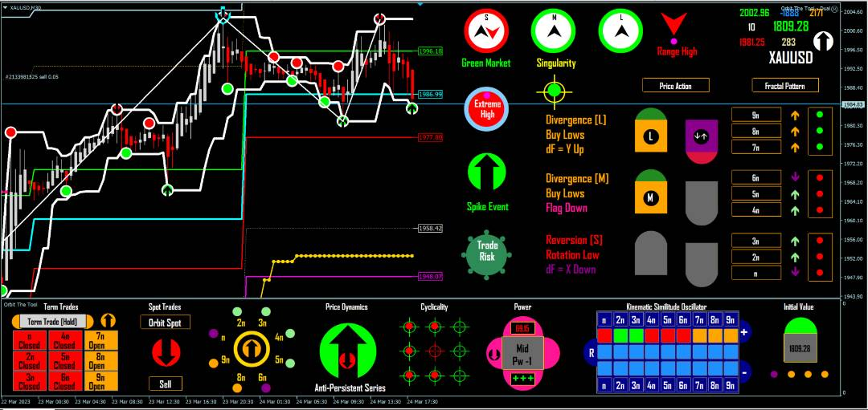
Intensification id
1
D
2
4
3
5
Compared to the slide before we see intensification in direction. These are the icons we monitor and how to follow this inductive process (i.e. a process that does not happen at once and therefore offers no predictive signals since it is the fundamental concept in math and not any indicator that guarantees the function).
Because no 2 cycles are the same EVER in chaotic systems and no matter the scale it is futile to think you can get an exact sequence in indicator signs that is consistently patterned in the same exact way – so it is the math that you keep in focus and as the screenface changes in a general way along the lines shown you can expect the down swing to complete. And so to trade the swing you can a) try to trade a single high point and leave the trade to fluctuate until breakout or b) you trade the crown and black arrow semaphore moves in the expectation of riding a high point into the down swing.

Slide 6
Conclusion
It is the QUALITY of the math and NOT any combination of indications that guarantee the moves.
This is WHY you must keep the function described in slide 1 in mind ALWAYS to understand what you are doing or what is going on.
Keeping the math in view, you read screenface changes as confirmation of the math. The indications on their own do NOT predict anything and change with the math. Finding specific combinations of indications is good in a general sense but know that NO 2 cycles are the same EVER so exact combinations repeating in the same way each time are rare. It is the general case that you follow.
It is simple because the math is a function and we follow the function from changes in the screenface along the lines of our expectations. Indicators are slaves and not masters they follow they do not command.

