Slide 1
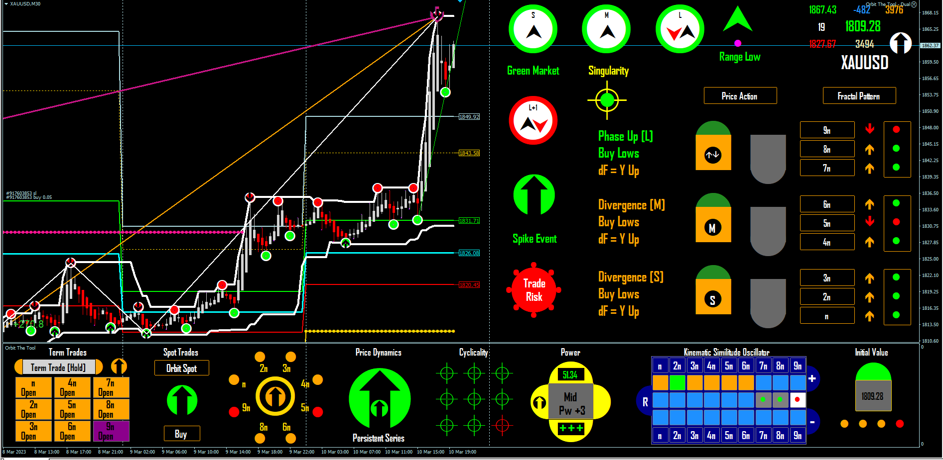
A
First please observe with care the order of bars (folding and stretching), and how this order defines a price cascade (in this case a positive cascade). Visually, the evolution of this cascade shows that the NFP’s trade direction was a determined function well ahead of the event. Therefore, this is prove that a deterministic system admits no randomness in its future states.
Next observe the topology marked A and you will notice a fluctuation in progress (end behaviours). Within this topology price places a crown at the top (call this stop 1 red), then drops to stop 2 green. Stop 2 green rotates the variable higher and toward stop 1 red. (continue on next slide).

Slide 2

B
In B and within the given topology, the translation from stop 2 green to stop 3 red < stop 1 red is complete.
As mentioned above in the slide for A, We are in the topology that describes end behaviours or a point stop (end of the move), and what you are seeing is one of the routine sub patterns (pattern within pattern), by which the system (market), ends a flow. This is part of what we call dynamical patterns or the sub patterns that indicate specific information about a flow. In this case the system (market), is about to cap the move. As an Orbit trader I know this is also a good place to Take Profit (notice that to this point I am still trading and have not taken profit).
Dynamical patterns is not comparable to the apophenic “price patterns” in common use and it is an important part Orbit reads as you will see. But please to complete this review continue to the next slide.

Slide 3
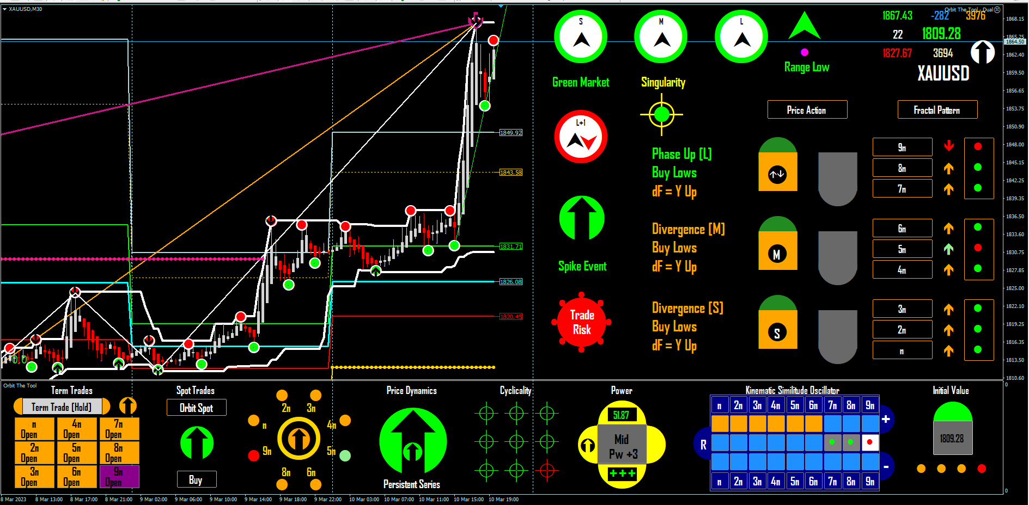
C
Here in C after allowing some 15 minutes to pass without an immediate follow through from the system (market), I took profit. As indicated we are in a Crown capping move which means the final point may not be more than 100 – 200 points higher than the cap on screen now. I was already over 3000 points in the money and I was tired (this was close to day close in clock time). So I exited my NFP trade. Pretty cool I would say.
But was this the end of the move? No and for reasons given above I had enough. So my point is to show that there is no randomness in the system (market) whatsoever and that the market is a mathematical construct to dot driven by an equation with an inverse on. A system which is not driven by an equation would NEVER behave as you can see and as I am describing in details that you can observe with your own very eyes. See final slide

Slide 4
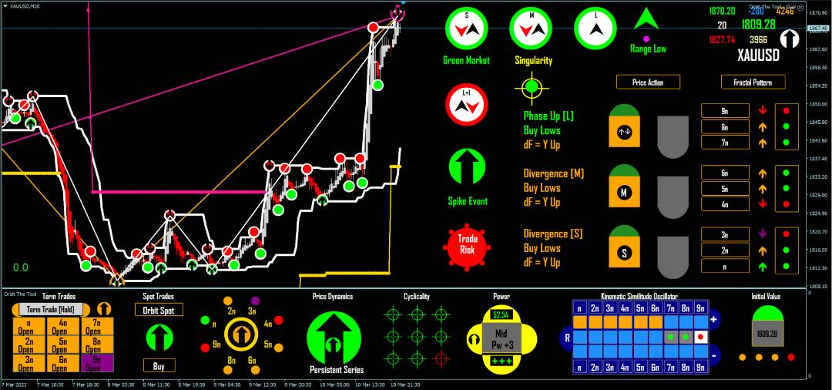
D
The final screenshot D is what I met the next morning. The system (market) had executed the final dynamical pattern to cap the move (Spike Event), at 1870 and importantly by stop 2 displacing a single point (stop 1) to a Crown Cap with a final inversion high.
People say where is the mathematics ----> you are looking at it, a Homeomorphic bijection with inverse on.
You see the transformation from Crown Low to Crown High, you see the order of bars neatly set to reflect repeated folding and stretching and so something as complex as a the market cannot be so mathematically well behaved unless underpinning its workings is an equation. When you learn to trust this statement you begin to trust Orbit and that is what leads you to winning consistently. Orbit traders MUST first accept the evidence that the system (market), is chaotic and that they trade an evolution within an Oscillator model of the market that is correct in order always.

