Slide 1
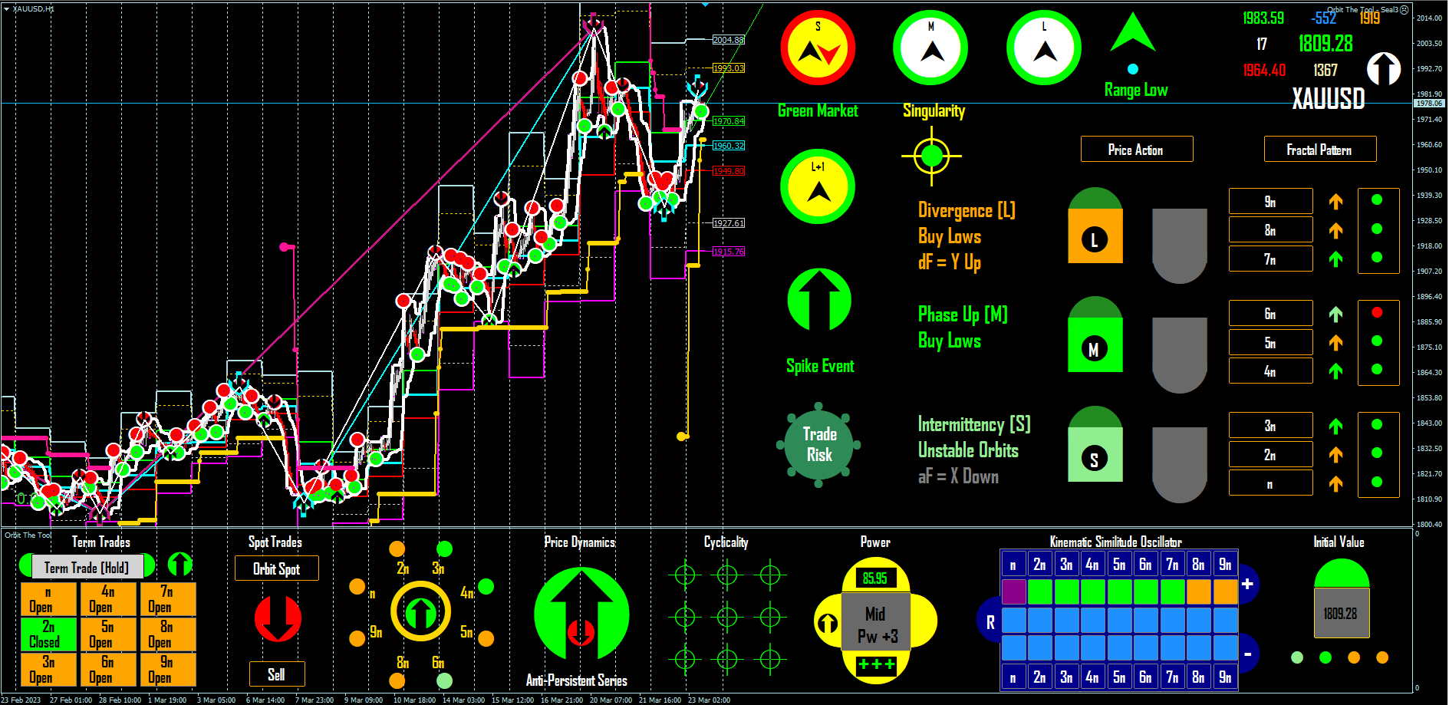
End of Diagonal (M)
Inverse On Trading
EXIT
SELL
???
EXIT
SELL
EXIT
Buy
SELL
Entry
Buy
Buy
Entry
Entry
Buy
Entry
Diagonals within diagonal
Start of Diagonal (M)
Inverse on Trades in Direction
Take Profit counter cycle but note counter cycle trades are rough and short.
Why? Market fractals are affine.

