Slide 1
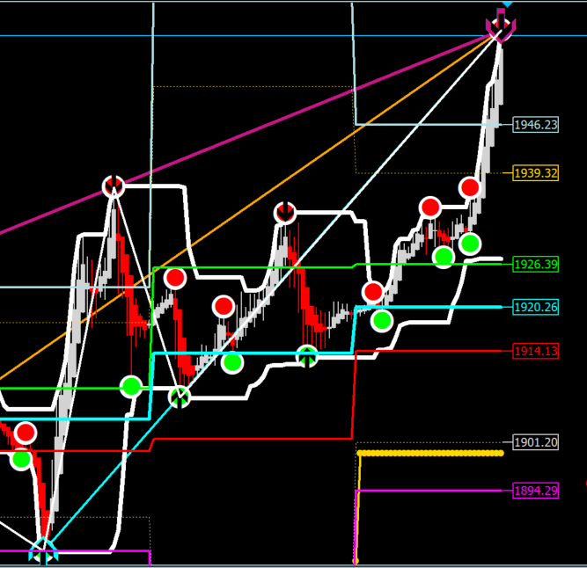
The Setup
C
Spike Event (High)
At A price follows the same pattern we study here (fold and stretch), but in the downward direction to establish a return point at low or what we call a Spike Event. A return point or Spike Event is marked by a “Crowned” Semaphore.
Keep in mind i) All price movement regardless of scale follow the same pattern. ii) Fractal does not just mean similar shape but behaviours. iii) We need to recognize the 2 behaviours (fold and stretch), when we see them across the feed (n – 9n).
At C price is again stretched or rotated in the upward direction to another significant high stop. i) Where would you say this move began? ii) Can we say the move had root in any of the black arrowed Semaphores? From other market windows you have checked, would that also be true? If so what do you think will happen to your profits if each time you entered trade on a black arrow in Finite Loop Equilibrium (FLE)? Can you count the moves between the black arrowed Semaphores?
B
At B the return point at low rotates (stretches), price to a significant stop high, and we are back in repeated folding behaviour. This is loosely called “range” but it is a specific pattern (folding), i) Observe this truth from the Black Arrowed Semaphores ii) Randomly cross check time frames to find the behaviours as shown here and see if iii) You can easily identify them, and iv) Whether you can see the black arrowed Semaphores in the same positions as they appear in this example from the 30 minute market window (up and down).
Spike Event (Low)
A

Slide 2
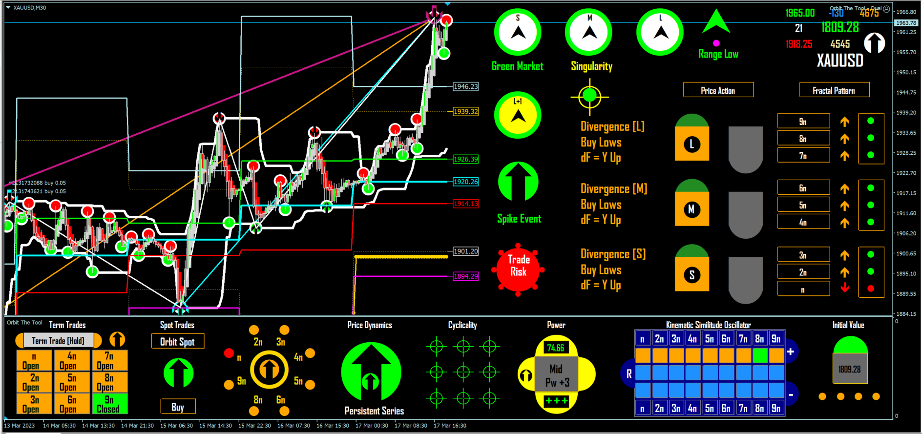
Trading (example: up move but inverse is true)
FLE 2
FLE 1
Setup = FLE 2 (current MRI Fibonacci Range)
On Semaphore Low + nCyclicality +VE = Inverse On = Trade id
Command is good for point to point loops until (breakout or), stretch mapping
Screenface registers inform on and track progression of move
Termini (stop) = new instance of FLE
Notes: Stop Loss logically set = Thesis = Inverse On (tight but most effective stops and low cost)
The above are NOT rules they follow from the intrinsic behaviour of the variable and are consistent always.
Therefore, this is the simplest, correct and safest way anywhere at all in trading to trade markets for the most returns.
Determinations such as to trade loops only, trade Inverse On + loops, trade Inverse On only are for trader to make.

Slide 3
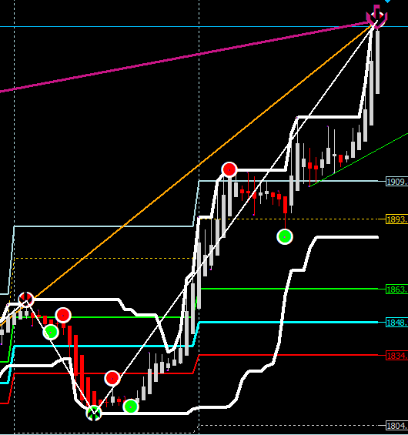
Fractals the same in form and behaviour
1
3
As simple and efficacious as the Inverse On command is, it does require that one is strict and never try to jump the gun or in other ways vary the notion as presented. If you read the associated mathematics I have pointed everyone to, simple mathematics anyone at all can get, it is soon obvious to you that the idea is not to reduce the degrees of freedom by which the system (market), works by exogenous “rules” that only live in our uninformed imaginations but to work within precept.
So within the degrees of freedom by which the system (market) operates, the Inverse On command is the way to trade any market window at all. Starting to encumber the market with non chaotic notions or rules (including stop loss), etc courts trouble. Because what do you KNOW about the dynamics of markets outside of chaos to develop such? This is why I have often said there are no rules we simply follow the market based on its behaviours.
Above is a screenshot of 6n the cumulative of n -5n fractures, and thus the intraday cycle in effect. Most traders are day traders as I understand it and are so mainly because of misconceptions about how the market works, availability, and notions of riskiness derived from non-science based traditions. But how would you trade this window given what you know now about the sense of the Inverse On command provided here? The same as the M5, M30 or even M1 windows or different? What difference is there between those and the H4 window?
2

Slide 4
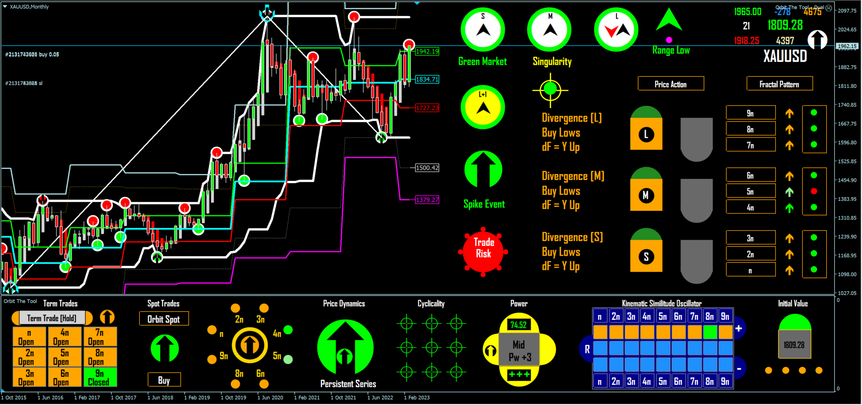
The Market as a Singularity
Similarly, this is the 9n Gold (or MN) window. Look at the order of bars over years and then look at the behaviour or pattern of Semaphores. Does it differ from any other trade window? What do you know to add to this or any other window to “give you the edge”? Is there an edge anywhere to be had? Is the edge not simply knowing the behaviour or chaotic pattern of price?
Orbit presents the market as it works and is NOT a trading system because it is an Oscillator Model of the market. Orbit’s accuracy derives directly from reading the equation that drives markets in real-time. Can you form a different equation? To do what?
So Orbit the Tool even in the current form (a prototype), is complete and sufficient to make the market however which way you wish to trade and all you need to know to trade markets is the Inverse On command regardless of scale or style (scalper, day trader, swing trader, or position trader). The market is a singularity (a single point), and you merely track its evolution from any window that you elect to the same effect as any window available.

Slide 5
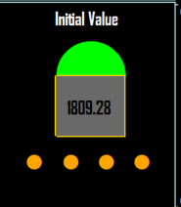
The Market is a Mathematical Construct
The market is a mathematical construct. A chaotic system underpinned by a fractal structure. Knowing steps and rules (defining “technical” trading systems), to follow it is not sufficient to trade the market with strategic dexterity. You need to know some of the key aspects of the mathematics that defines the construct to define its most active and most important property - dynamics. It is such understanding that gives you the confidence to not only be sure of what you are doing, but to enable you make determinations about how best (the most profitable way), to trade (within what you now know and your personal circumstances).
Above is a simple phrase or term – Initial Value. This term however is critical to understand and underpins notions such as “the butterfly effect” or extreme sensitivity to initial conditions. In the manual we touch on all of such and explain in the most basic sense what they mean. It is a basic understanding of these that allow your departure from the tenebrific ideas of the market prevalent in other traditions and therefore, to adopting the idea that Orbit the Tool is the simplest and most powerful sense to view and trade the market. I hear persons here say, I do not want this or that I simply want it this or that way (i.e. the presentation of Orbit), or why do you not add this or that, etc. Well first know what you are talking about and the only way to know is to read about stuff (not just from the manual but wider), and do so even when you can use the Inverse Command to make a lot of money. Money is nothing but knowledge is everything.

Slide 6
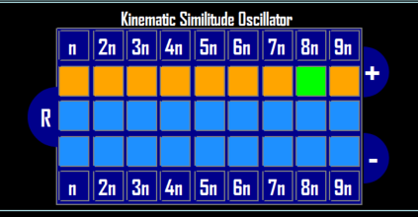
The Screenface is Key
Now and hopefully, everyone knows how to trade the analogue equation – Orbit the Tool. And it is decidedly simple and straightforward. But that is the easy part. The tough part (though not that tough with practice), is to coordinate your trading sense with what the screenface is outputting in real-time. Please look at the screenface and tell me how it is possible to instruct on using every part in different ways and in different contexts, for different combinations of icons, at different times, etc. It will take years and tons of paper to explain satisfactorily. Yet without at once knowing the meaning and context of what the screenface is outputting you are not necessarily guided trading by Inverse On alone. The solution is simple because the design of the screenface is to render intuitively explicit information underpinned by a convergent/divergent colour surface. The idea is that for everyone, at some point, a glance is enough. So again visit the manual from time to time, observe the indications as you trade, note contexts and especially come to the forum and share your thoughts and gain insights from sharing insights. One reason I appear to bore people with my vision of the cloud based version is that no one here will recognize Orbit the Tool as expressed in the prototype when we are done with the cloud version. The graphics, animation capacity, the scope for dynamical and context driven information is restricted in MT4. The same tool in cloud version is ten times more powerful and to my mind – would be everything anyone ever wanted in a trading tool.

Slide 7
Market fractals are affine fractals and the simplest colloquial (trading), sense of that is that all points “trend side” are displaceable one at a time and all points “counter trend side” are potential return points one after the other. Both sides subject to the presence or lack thereof of Momentum in Direction. So as a triangle the sides are unequal and the X and y axis measure differently. I am talking here of a dynamical construct.
So you cannot force anything (including knowledge of the actual dynamics of price in space), by forming spurious and baseless rules in the hope of gaining advantage somehow of something you have no clue about (or even assume you are avoiding risk by constraining the degrees of freedom within which the independent dynamics of pride express).
Rationally, price will express by the intrinsic symmetry that defines it and it is the mathematics and not what you want or hope for or think might work that drives outcome. In other words, it is what is known by that body of knowledge that you must follow: So below is the sense of the Inverse On command by which to trade by Orbit the Tool. You will find that it is the simplest, most accurate and least risky method to trade any market at all. Indeed, I think it is because of its simplicity that everyone confused as to how to trade Orbit – since when we say chaos theory, everyone anticipates complexity but applied as it is in the tool – it is in fact the mother of all simplicities.
The Crow (-_-)

