Slide 1
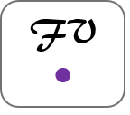
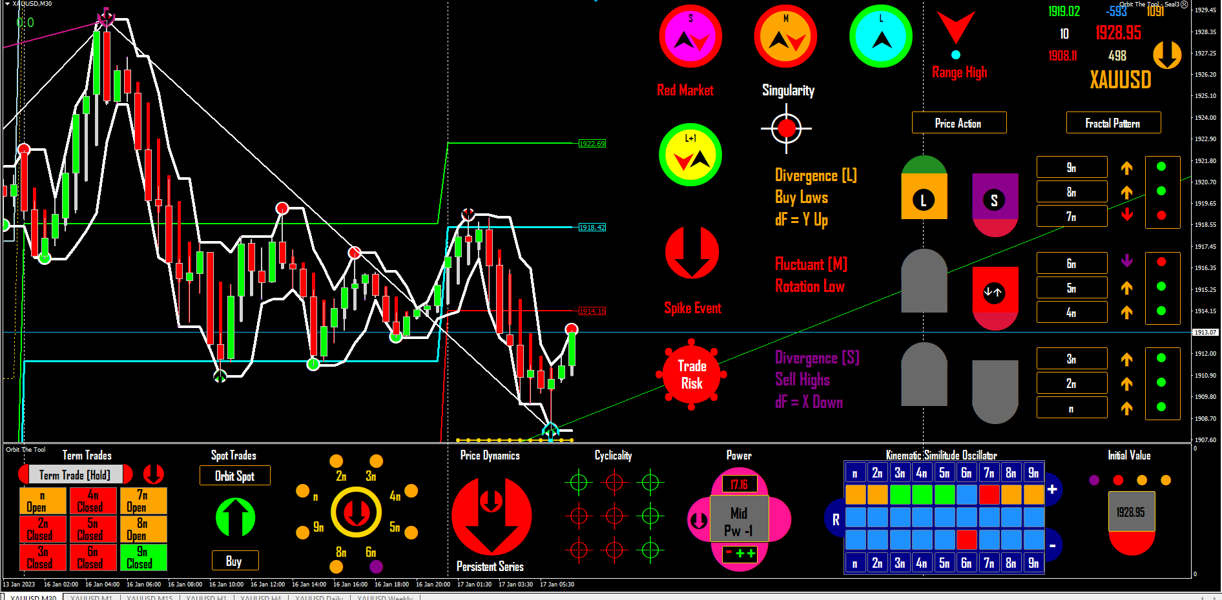
Introducing Orbit the Tool (Working Prototype)
All you need to know to use it, understand it and think about it!

Slide 2
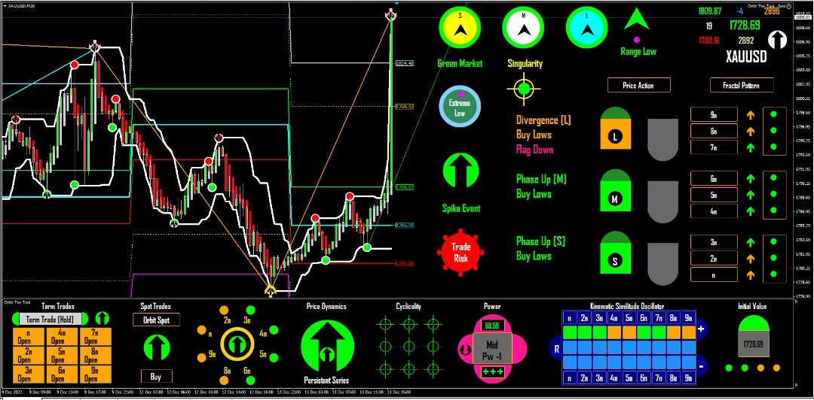
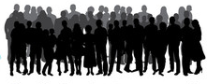
Introducing Orbit the Tool (Working Prototype)
Orbit the Tool
Correct 100/100 Times
Mathematically, Orbit the Tool is an Oscillator Model of market movement. An oscillator model is a dynamical model in which the variable evolves through a periodic (or, in the case of markets, an aperiodic trajectory) or orbit (in ambient space or range). This periodic trajectory is a loop through ambient space as the state of the system returns to where it began after some indeterminate time. This loop through space is called the phase of the oscillator. Orbit the Tool follows this loop exactly for all electronically traded markets in real-time.
X _{n+1} = F(X_{n})
New to Industry (NTI)
Orbit
Zero Risk Trading
Visual , easy to learn and trade
Changes the Way Trading is Done Forever

Slide 3
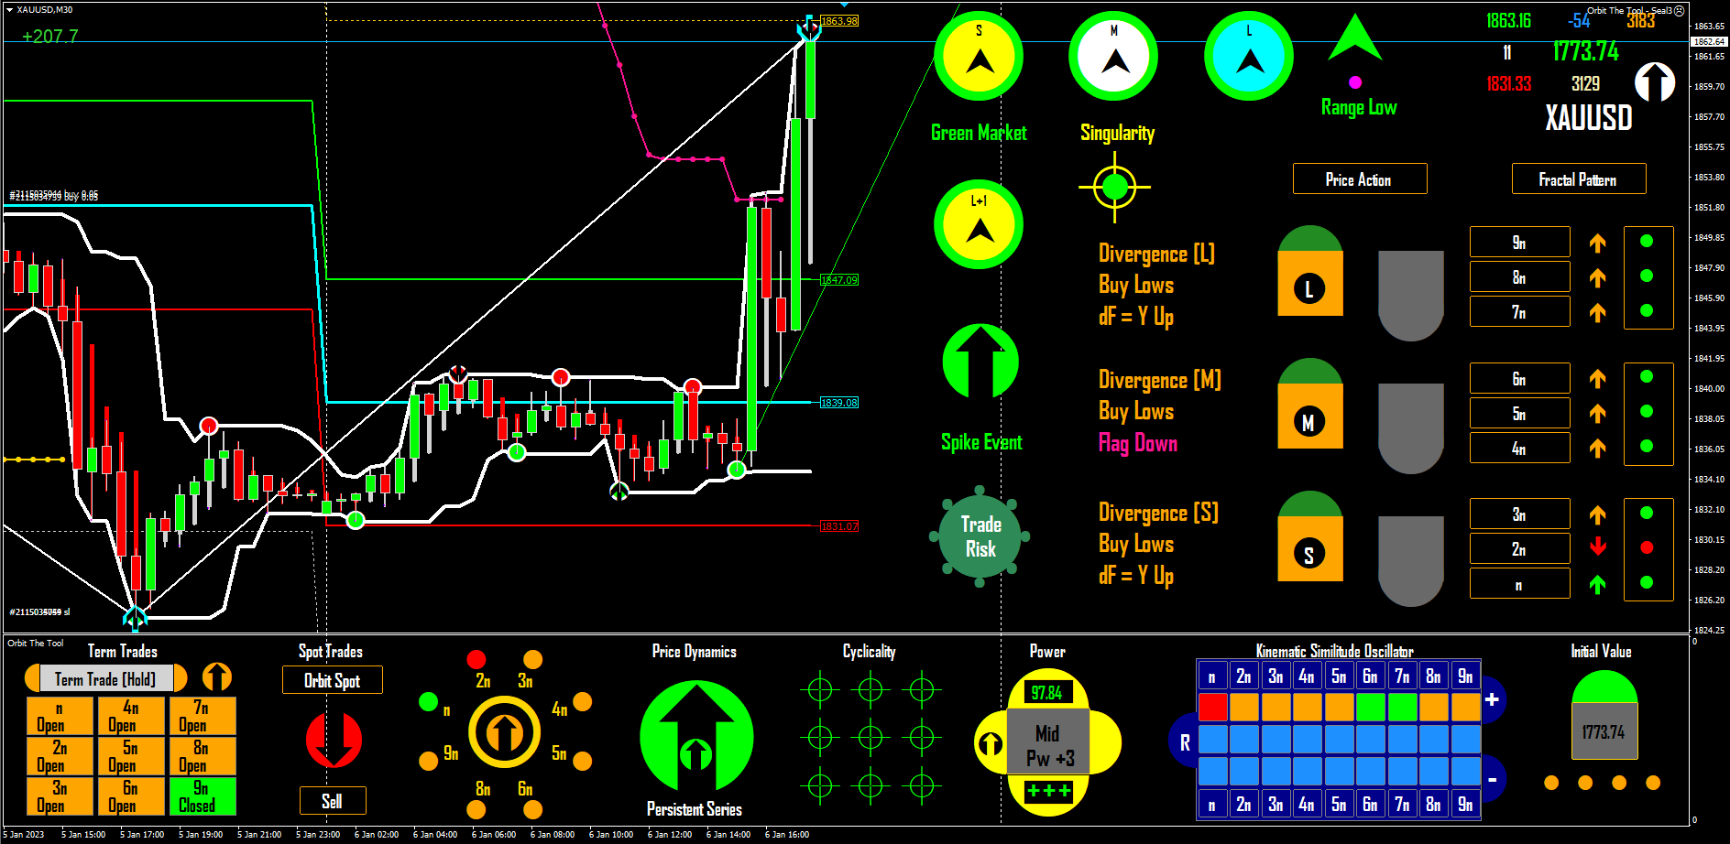
We Answer the end Question with the Slides following:
Read the story (i.e. the comment on the story), to understand the context of this particular NFP day trade, an example of one of the many powers of Orbit the Tool. Click the link below (in slide show mode), to go to the relevant post on FF
Profit so far
Entry
K Identity {+VE}
Cascade
Initial Value
Motile
Stationary
How could we have calculated the market so precisely?
Look at the details of the trade well. Then think about it!
Orbit The Tool
https://www.metalsmine.com/news/1198500-golds-1900-target-slips-away-as-employment-outlook#post14278345

Slide 4
KSO Band Persistence
On each page some background then read the dark brown text as you go
+
An illustration of the intuitive sense of the oscillator model – Orbit the Tool
The Kinematic Similitude Oscillator
Parabola
+
R
NOTE: This is a way to think of the model and how it works in practice when trading in real-time.
-
Trading the singularity (price), by the oscillator model (Orbit the Tool), is similar in operation to the standard way in mathematics of representing a complex dynamical system such as the market. In simple terms, the model follows the variable price, as it loops through ambient space every scaled cycle (in any traded market).
Which in effect means, trading by reading a parabola, a quadratic with a single maximum (the market equation). There is not much therefore, that is speculative when trading by a mathematical model. The trader can be confident of making the correct trade decisions nearly always.
We account for all types of similitudes in price fluctuation within the overall model - kinematic, geometrical and dynamical.
Parabola
KSO Band Persistence
-
Orbit is a market model, not a trading indicator/or a trading system.

Slide 5
Aperiodic Cyclicality and Oscillator Synchrony
KSO Band Persistence
Phase Coherence
+
The model is a mathematical reading and articulation
of the behaviour of the variable price in live markets.
Fractals scale, so, price does not “trend” it scales – the power law applies
Exhibits self-affinity
For instance, the context reader Cyclicality, as a measure of Phase Coherence, is part of a set of readers that read various conditions dynamically within and across Time Partitions or the feed (n – 9n). ALL such aspects of price fluctuation are calculated in interaction to provide the trader with actionable trade commands ahead of the market.
KSO Band Persistence
-

Slide 6
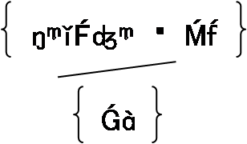
Trading Orbit 001
Unscramble Time: The Fractal Footprint
Point Weights
Y
-
Orbit reads the market like a book.
=TrendLock _{P/P}
Not a secret except for the way we have adapted it.
Visibility A, G, M
Breaks time up into clock/market time (split into folding and stretching time). Provides saddle values in pattern and more, all within 4 hour partitions of unit clock time.
X
₊
The Market as a Triple Pendulum
Orbit Dynamics Up Flow
Analogue of Market Chaos
Time is a most critical variable to analyse in Trading

Slide 7
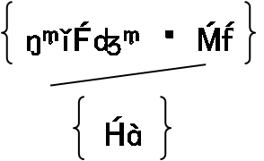
Unscramble Time: The Fractal Footprint
Trading Orbit 001
Y
Breaks time up into clock/market time (split into folding and stretching time). Provides saddle values in pattern and more, all within 4 hour partitions of unit clock time.
-
=TrendLock _{P/P}
Not a secret except for the way we have adapted it.
This means Orbit reads the market correctly 100/100 times. It does so by reading a pattern of points that fit an equation of markets (or what is called the Rules of Recursion in fractal geometry).
Visibility A, G, M
Point Weights
The Market as a Triple Pendulum
X
Analogue of Market Chaos
+
Orbit Dynamics Down Flow
Time is a most critical variable to analyse in Trading

Slide 8
Trading Orbit 001
Point Displacement/Replacement Dynamics
- Retrofitting
-V. Line
Spike Event
M(5)
M(5)
n^{D} = {X_{y} X_{x}}
o
No aspect of price fluctuation is random.
n
id_{H}
S
=
n³ - 2
> 85
2s
(For any Unit of Fluctuation),
M(5)
X
^{4c}
every aspect important to the spike event ahead (high or low) is accounted for,
M(5)
Y
^{4c}
^{ii)}
^{ii)}
n
So to trade by Orbit, a trader simply follows its commands.
Period!
id_{L}
^{iii)}
S
=
n³ - 2
< 15
^{iii)}
2s
Inversion Low
when you know the initial value exactly.
Inversion High
n^{D} = {Y_{x} Y_{y}}
X
^{4c}
o
Y
^{4c}
Initial Value
Initial Value
^{i)}
Spike Event
^{i)}
Dynamical Similitude
+V. Line
Rotations (Triangulations)

Slide 9
Tracking the Parabolic Path of Price
-Growth
>> 1
^{So you} can Tell where you are on the curve, what's going on and what will happen next.
Stretch
Variable
Return
-Growth
= 0
Inverse ON
Intermittency
Behaviour Sequencing
Invert
Anti-Persistent
Fold
Anti-Persistent
Fold
Invert
S
Intermittency
+Growth
= 0
Return
S
S
Inverse ON
Variable
Stretch
Parabola
S
S
S
+Growth
>> 1
What do term arrows read?
Which means that trading the tool, amounts to making trade decisions based on Orbit commands, from trade to trade.
S
S
Shadow or Analogue rates of continuous deformation (homeomorphisms).

Slide 10
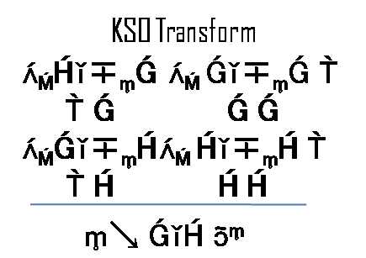
The Anatomy of Price Cascades
^{Topological} Transitivity or mixing
Fractals are infinitely complex (detailed), and the term infinity has special prominence in fractal geometry. That is, in the sense of the Mandelbrotian calculation of the coastline of GB to infinity. You find the same symmetries and similitudes, etc within and across all time partitions and there is no end. Again, there is nothing random about price, its fluctuation is everywhere the same and you see this everyday ----------> the same.
Inverse ON
^{A} demonstration
K Identity {-VE}
Rotation High
K Identity {+VE}
Mandelbrotian Randomness
Inversion Low
K Identity {+VE}
+/- MRI id Limit
Inverse ON
^{Geometrical} Similitude
∞
Across all market topologies
^{Orbit} reads topological invariance
Weighted Pivots (nested)
Inverse ON

Slide 11
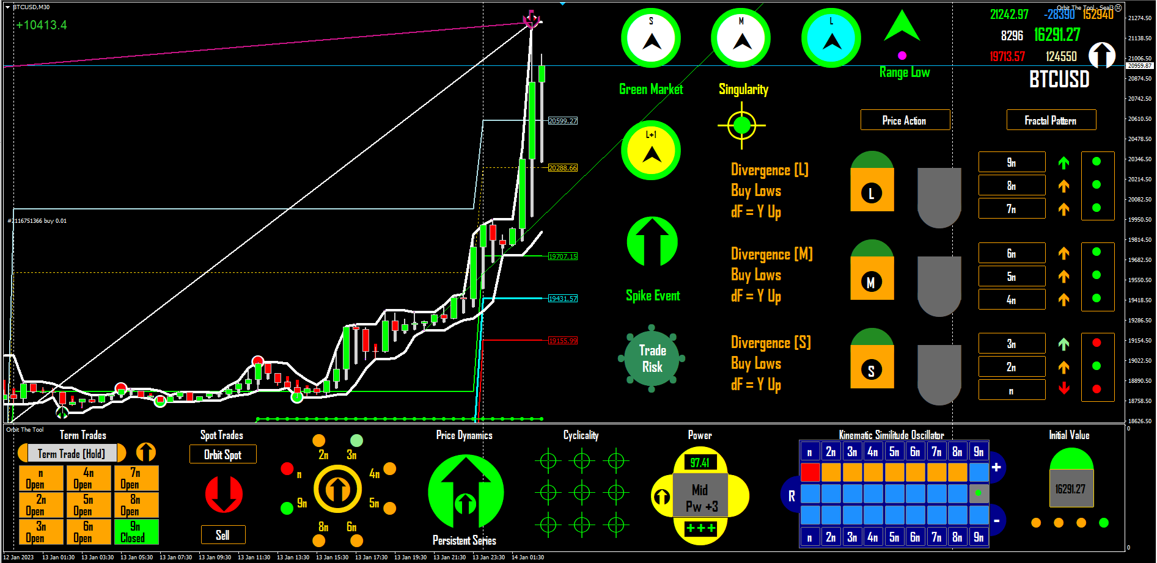
Trading Example: K Identity = {+VE}
Profit so far
K Identity {+VE}
Entry
New day Open
Initial Value
Cascade
How it works
^{Simply} Follow the Command
The Future Now

Slide 12
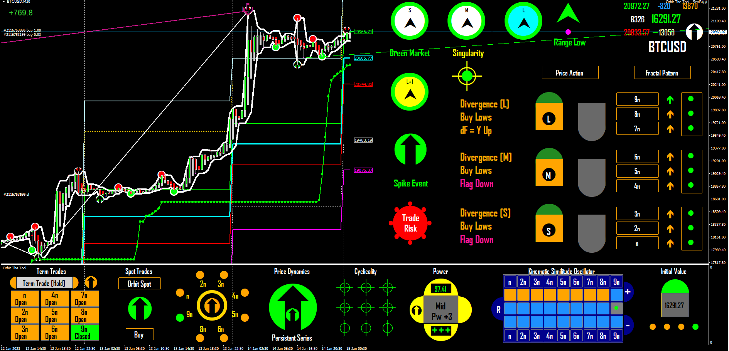
^{we know} Lightening like price, is a fractal. It strikes a single point with an infinite number of parts – all the same
Profit so far
K Identity {+VE}
Entry
Next day Open
Initial Value
Cascade
Cyclicality 100% to the very last point.
^{The} Next Day, The Same Command or Another to Follow
The Future Now
and You KNOW which, before the market

Slide 13
^{On the screenface} the colour inverse, always equals true
^{which means e.g., the colour} δ^{of S,} ^{as with} ^{every Icon} always equals true.
Inversion Low
Inductive Flow
Initial Value
K Identity {-VE}
Calculations from n – 9n read the right-hand edge (RHE) of markets
^{We learn} to read ^{the colour combinations} ^{and changes as} patterns and to tell what the changes mean to price action in real-time. The colour changes are actually numbers changing by a set of rules to effects we can see.

Slide 14
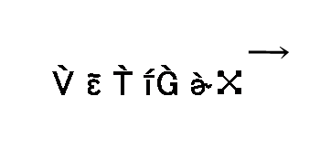
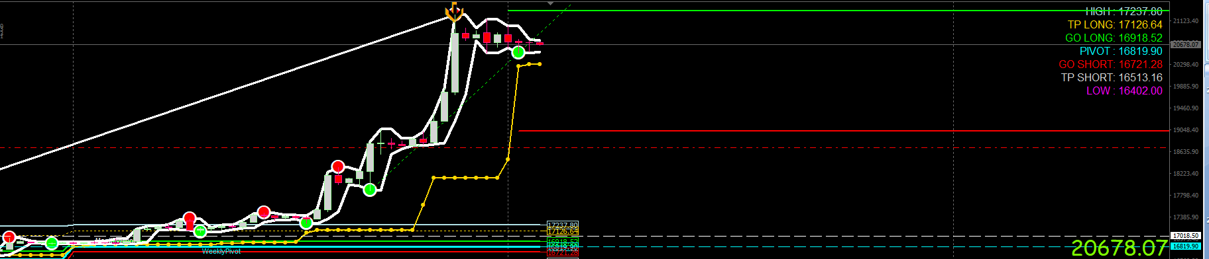

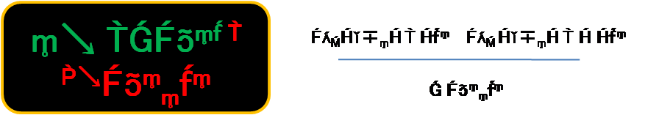
^{Beyond the} Prototype
Orbit the Tool
Where is the risk?
FLE = infinity
TF = K Identity {+VE}
Initial Value
^{Inversion High}
^{“At} Limit = FLE“
^{“Inverse} on“
^{“Topological invariance “}
Market Strange Attractor
Recursive
KSO Transform
Result
X = W(1)
Correct 100/100 Times
Exact Timing in Direction.
Over and over again
^{the} Trading Platform

Slide 15

So what am I saying in so many words?
I am saying that above, I have shown graphically in using live trading charts, that the mathematics is correct to the motive point (initial or seed value).
This means correct to the singularity.
But that is nothing, it is not about whether Orbit makes money. It is about how much money and quality is promised.
To test this, learn to trade the tool. This helps you to mentally multiply your results (money and quality), by the future and see the advantage of trading by the science of trading. It was always a question not of the efficacy of Orbit as a tool, but of the scale of the resulting paradigm shift – a question of whether or not the equation works as demonstrated. A question of mathematics, a question of the singularity as price.
^{Ready to} be the Platform of Choice
Orbit the Tool is Ready, and
Correct 100/100 Times
Over and over again

Slide 16
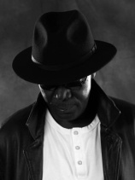
The Darkdoji
In the slides that follow we show as we have above, more of how Orbit reads the market (or more correctly market topologies). It does so exactly, and with results consistent with precept.
Orbit reads and writes the market down and the trader simply reads Orbit. Every fracture is a sequence with a begin point and an end point. The same shape at different scales and recursive to infinity. A complex dynamical system.

Slide 17
A key topology
The Finite Loop Equilibrium (FLE)
{{idc, TF K Identity = {-VE}}
S²
δV Line +(Chaotic Sq) ->_{n}Pi + n inversion
The same as Infinity
else = {+VE} S², Inverse = true
n^{D} = {X_{x} X_{y}}
o
3s
-V Line, ap = T+1
n
Secret arrow agreement
qualifies Path, ahead of market
id_{H}
=
n³ - 2
> 85
2s
(FLE)
You know where price is headed each time, and before it moves in direction each trade.
- Growth = 0
4s
5s
Alt V.L. Breaks
Inverse ON
+Growth = 0
n^{D} = {Y_{x} Y_{y}}
o
n^{D} = {Y_{x} Y_{y}}
Approximations of Infinity = The FLE=The beginning and the end (of each sequence regardless of scale).
o
n
id_{L}
=
n³ - 2
< 15
The Asymmetric Case
2s
+V Line, ap > T= 0
Note: The symmetric case is only slightly variant.

Slide 18
KSO Band Anti-Persistence
The Matrix of Diagonals
o
Multidimensionality
+
Scalar
Pi = n {[n [-->Y1)) ---> (Y2)}
Path dependent
Mandelbrot prescribes that markets have memory. We agree by alternative analysis.
Index Set
Pivoting Index
n 5s = motile
Y
Depth
_{n}
_{3s}
_{4s}
0
0
_{D}^{5s}
ID3
2
1
0
0
0
0
+/- V Line ap
ID2
2
2
1
2
0
1
ID2
2
2
2
2
1^{d}
1
KSO Band Anti-Persistence
ID1
4
3
3
3
X
1^{d}
2
-
Variable Topologies
Iv =T -1, Doubles K^{3 --->}
Initial Value - stationary
A chaotic system behaves like computer code exactly - clock work
Initial Value – motile
Initial Value – image
In the language Orbit reads

Slide 19
FLE Translations in id range
Cover: TFs -1, -2, & -3
From the now to the future
5s
2s
Observing the depiction here in any live market, it is incontrovertible that you have a bijective process with an inverse on. The rest is easy.
1s
^{TF-1}
Inverse ON
^{4c}
3s
^{x/3 - n}
Equinumerosity of Points
3s
An equinumerous set of values , sequencing all fluctuations in bijective streams - a pattern.
4n^{D}
+Growth = 0
n
id_{L}
=
n³ - 2
< 15
+V Line, ap > T= 0
2s
The Asymmetric Case
Orbit the Tool reads the market in this way exactly and in real-time.
Note: The symmetric case is only slightly variant.

Slide 20
5s
Saddle Values the central part of the fractal footprint.
2s
_{Behaves} or emulates a cubic function in that part.
M
Analysis by definition is finding the essence.
II)
TF +1 V. Path Dependent
III)
S
V. Line Hold TF -1 + TF
I)
S
Kinematic Induction
Chaotic Analysis is not about “trend,” it is about changes in fluctuation and direction across changing market topologies at scale.
V. Line Hold TF -1 + TF
Stepped Moves
3s
Initial Value
V. Line Hold (2) 5n to 6n
Inverse ON
V. Line Hold (1) n to 4n
K Identity Inversions
Inverse ON
a
b
c
Retrofits
Again!
Initial Value
3s
Markets “Repaint” all the time and in this way “whipsaw” using valid inversions in the pattern
I)
S
S
II)
TF +1 Path Dependent
2s
III)
M
5s

Slide 21
Trading Orbit 001
Orbit Dynamics Up Flow
KSO Band Persistence
Line Return & Continuous Cascades
Fractals topologically notify symmetries and asymmetries that are the same across all scales. Thus providing a rich source of trading information in real time. This is what behaviour sequencing is all about.
≥ 3
+
Rotations
It is not in the shape, it is in the numbers that make the shape everywhere the same over and over again.
n^{D} = {X_{x} X_{y}}
≥ 3
o
2
2
Break Lower
2
KSO Band Persistence
+VE Continuous Cascade
-
Uptrend
Behaviour Sequencing
≥ 3
Price is a fractal, a pattern that is exactly the same across all market time scales.
Query Breakout

Slide 22
Trading Orbit 001
Orbit Dynamics Down Flow
Query Breakout
Downtrend
KSO Band Persistence
≥ 3
-
2
-VE Continuous Cascade
Breakout Up
2
2
“ Fractal geometry is not just a chapter of mathematics, but one that helps Everyman to see the same world differently.” - Benoit Mandelbrot.
≥ 3
n^{D} = {Y_{y} Y_{x}}
o
Rotations
Fractals topologically notify symmetries and asymmetries that are the same across all scales. Thus providing a rich source of trading information in real time. This is what behaviour sequencing is all about.
KSO Band Persistence
+
≥ 3
Line Return & Continuous Cascade
Price is a fractal, a pattern that is exactly the same across all market time scales.
Behaviour Sequencing

Slide 23
Visually Translated Interface – Trading Commands
Range High Arrow
Red Crown
Secret Arrow
Term Arrow
S
Projected Diagonal
Red Crown
idc Cyclicality
Green Crown
idc Cyclicality
Projected Diagonal
Term Arrow
The trader need not know the mathematics and only need know the command to follow.
Secret Arrow
S
Green Crown
Range Low Arrow
Note:
TF = Trade Frame = idc = 6n
Track by KSO & Cyclicality
Icons and Context Readers

Slide 24
Trading Orbit 001
Kinematics and Topological Live Reads
Early Entry
≥ 3
Late Entry
Live
RHE Folding
S
A fall in price for any measure of time and on any scale follows the exact same pattern and is the exact inverse of a rise across all scales. The process, strictly speaking, is a bijection.
S
1
RHE Stretching
LHE Folding
LHE Stretching
History
2
≥ 3
S
S
S
Induction (Intermittency)

Slide 25
≥ 3
Kinematics and Topological Real-Time Reads
Induction (Intermittency)
2
History
LHE Stretching
LHE Folding
RHE Stretching
A rise in price for any measure of time and on any scale follows the exact same pattern and is the exact inverse of a fall across all scales. The process, strictly speaking, is a bijection.
S
1
RHE Folding
S
Live
Late Entry
Trading Orbit 001
Early Entry
≥ 3
S
S
Orbit Dynamics Up Flow
S

Slide 26
Trade Analysis
(n) = {prima motor} m--------> M, m (∞)
Cyclicality/Orbit Arrow = Direction
Fracture Build = TF + 1: Is TF + 1 flagged? Is TF + 1 = New High/Low [Flagged) ID?
Fracture Build Completeness = TF – 1 = TF, = TF +1 ...n^{th}= Unity? Is TF +1 = a new Low/High Flagged and not ID?
Pre Translation Or
Unit Diagonal = {3n 5s] ^{4C}
Stand Down = TF + 1 C_{y} δ else persistence ID
6n Id Cycle = Id Limit δs per run
TF +1 Path dependent Trades ------------------------------------------------------------ >>>
Hidden values in topological limit codes = True
Topological Range Limits and Reversal Codes
There are no hard stops in chaotic space and given aperiodic cyclicality stop levels are unpredictable beforehand to any measure that is not topological.
At infinite numbers of bifurcations per period we must depend on the fractal geometry of chaos to read the space.
This means dynamically reading a nested system of spot pivots to base each stop to tell diagonal pointing.
To do so, we employ an analogue topological solution exemplified in the tables in slides 27 and 28 which ensure therefore, that we establish initial value and direction per interval 100/100 times consistent with precept.
This application with the implementation described and as witnessed by slides 27 and 28 Orbit defines a working deterministic chaotic model of the market accurate to infinity.
o
Topology & Mapping Notes to KIV
S
S
C_{y} δ
+
-
-
+

Slide 27
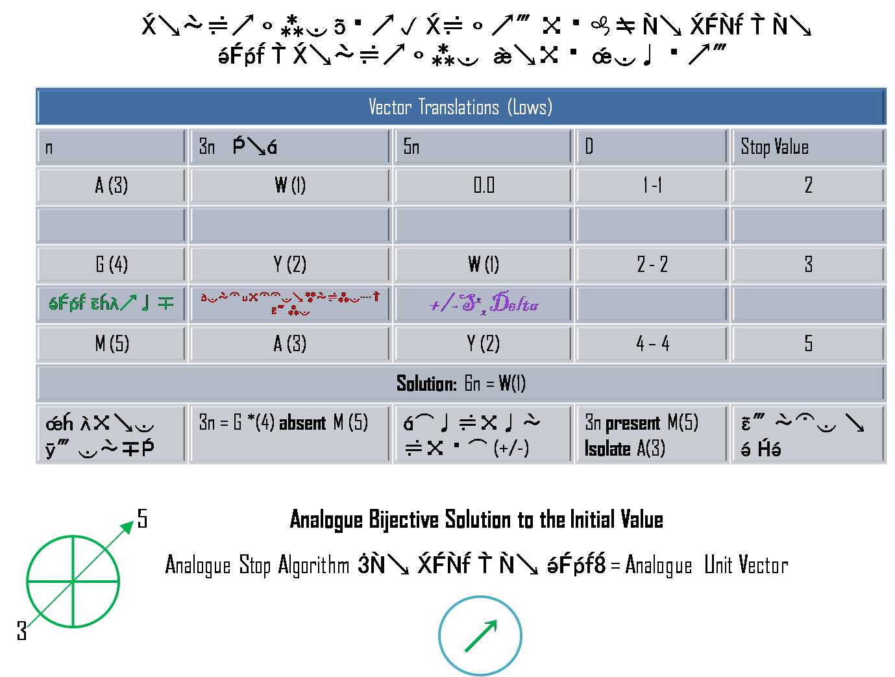

Slide 28
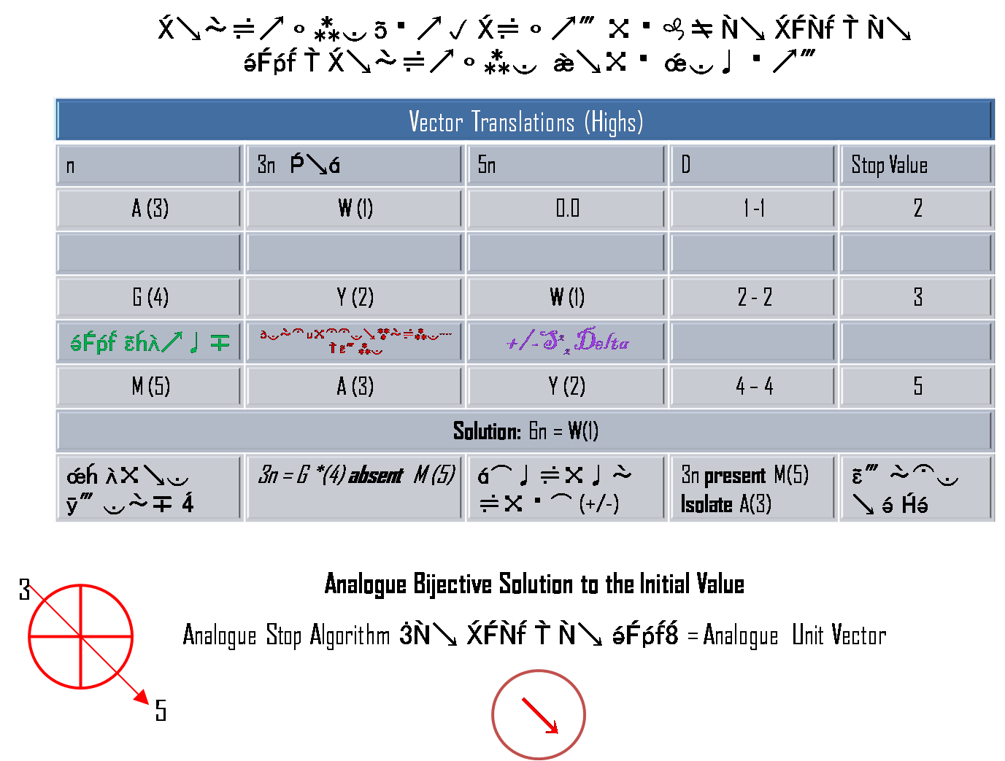

Slide 29
Order of Discussions
Why is it important to us that we discuss anew with traders?
Traders are not getting the point and are approaching Orbit as if it was a simple indicator or in fact trading system. It is not and people need to know exactly what it is in order to correctly engage with it.
So we demonstrate the essence of our invention and are prepared our own results from time to time.
It is only when the trader understands in depth what the invention is, that he can see the whole point and engage with others to profit from the tool.
What can we discuss at this initial time?
People have come to me privately offering money in the old culture of seeking personal advantage only and not common advantage because they do not understand that there is enough for everyone even when everyone can win consistently and it is by common exchange of technique that we can all grow to full understanding.
I am keeping no secret and no trader has the kind of money I need to put this tool in the cloud which is my vision ultimately. World wide access.
What is the end game?
The more that take interest and follow the thinking and find benefit from doing so the more the idea grows.
We ultimately desire to put the final product in the cloud so everyone can use it but that is still some time away – a long-term goal.

Slide 30
The way to think of why we wrote this note
Why is important to write and circulate this note?
In our experience of traders in general, we have found that there is no simple sense by which to communicate the concept of a chaotic model of markets, or the advantage in adopting the associated prototype technology, Orbit the Tool),
Traders simply lack the required visioning capacity (and tend to think we are suggesting something already in existence).
The idea of a mathematical model, appears intellectually inaccessible to traders, and as such traders appear constrained to think only within the current box of “technical” analysis and “fundamental” analysis in the face of a completely new and paradigm shifting idea (now turned into a reality).
It is important and critical to understand the newness of the idea and see beyond the current box And to understand that to learn the tool you must drop the current box completely and simply follow the tool.
Following the tool is awkward at first because you think you need to analyse the market first but all you need to do is follow its commands and gain the patience of markets because you do not really know and cannot guess consistently where the market is headed. But the tool knows so you must learn to pace the tool to trade it. Sure sometimes you think some signal should appear and it does not learn why by observing the tool for sometime to how it works and how it times it signals and soon you will see how to trust it and follow.
So kindly review and think about all aspects carefully, spend time observing the tool. Take an interest in the concept. What is initial value in chaos mathematics, what is a strange attractor, what is a bifurcation – Google up stuff just to gain a general sense not to take an exam or anything like that just to know that what you are doing trading the tool is real and different.

Slide 31
Epilogue :The pit is dead and so is the pit trader
The strategic blindside hindering market participants and especially brokers and traders is the failure to recognize that:
The Pit is no more, the pit is dead
And so is the pit trader along with his psychology, ideas, fears, greed or whatever else emotions, methods, understandings and knowledge associated with pit trading (the context from which current methods derive).
The pit has been replaced by the computer over 50 years now and the computer defines a microstructure that includes matching engines (creating a very different trading environment from pit trading).
There is no chaos in markets without the computer. Chaos is wholly a computer phenomenon for markets. Indeed both sciences applied in Orbit, could only be invented following the invention of the computer. Chaos and fractal geometry live in the computer. Without the computer it is not possible to define either and for some systems (like the market), to realize either at all.
But with the computer deterministic chaos theory becomes the valid way to read and trade markets ----> deterministically -------> everything else is a partial view or speculative reading, and as such highly unreliable to redundant (risky).
Participants without this understanding are at least 50 years behind the new (over 50 years old), market reality.

Slide 32
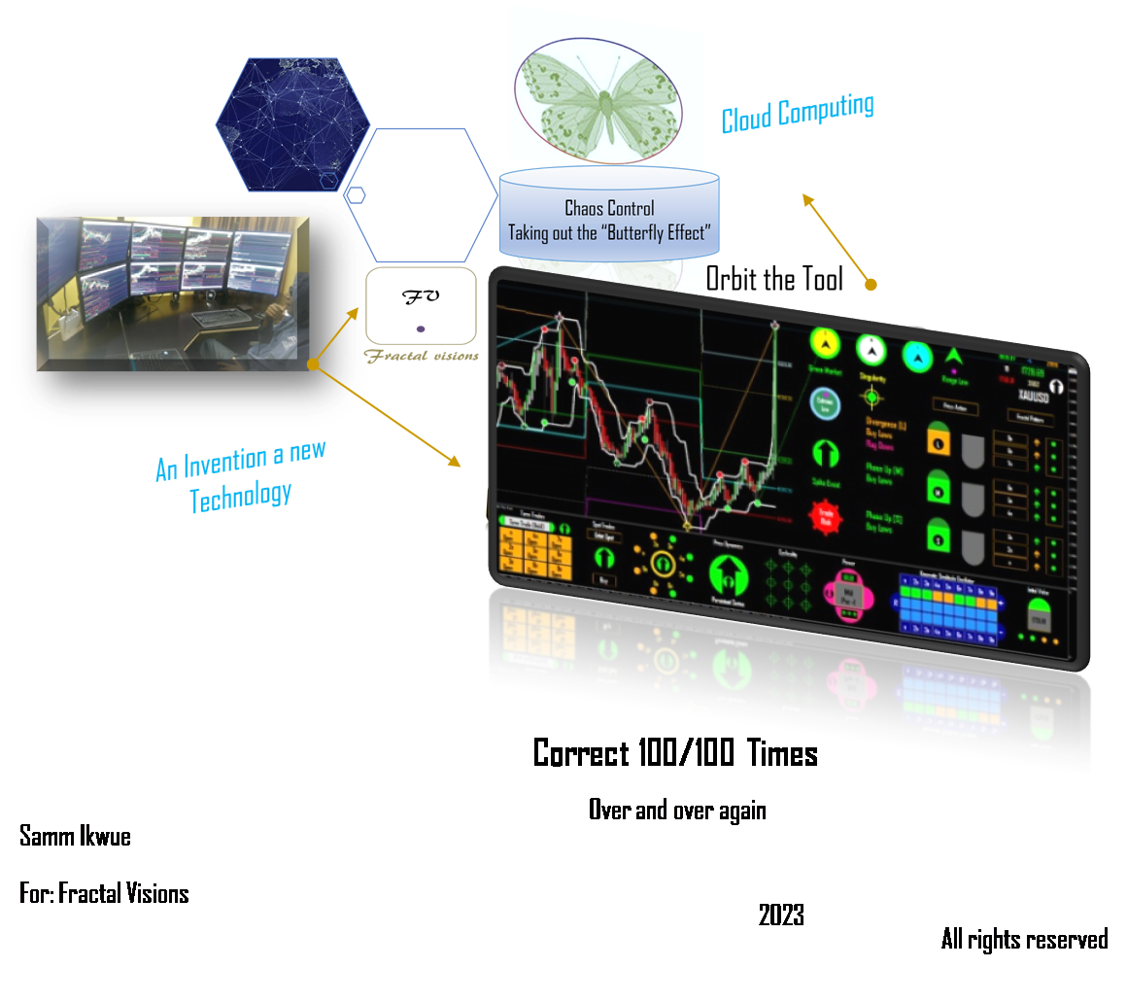
The Vision

