Slide 1
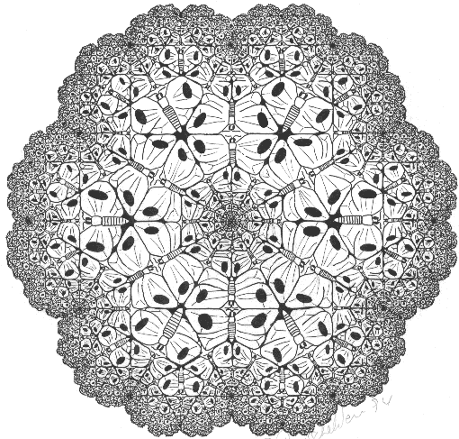


(The
chaology of
Markets) A multifractal trading model
“The whole can be broken into smaller parts, each an echo of the whole” -Benoit Mandelbrot

Slide 2
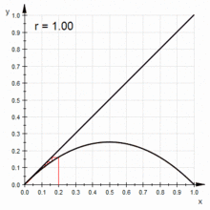
Background 1
Logistic Chaos: web diagram
Logistic Map:
Xn+1 = RXn (1 - Xn)
Any trader can understand the mathematics of chaos and how it relates to Stock markets, Forex markets, etc. In fact, it can be intuitive, where a trader trades with a need to understand exactly how price moves in real-time. As such, it is a powerful sense by which to understand market dynamics.
It requires an understanding of a map called the logistic map and how it outputs logistic systems. By noting the behavior of iterates over different rates of change (systems), and the specific character of their fluctuations (using web diagrams), a set of classifications emerge that specify sequences of iterations by their period-doubling behavior, i.e. the number of iterations needed for some seed x to return to some specified marker or point in range. It is this period-doubling behavior in iterated sequences that leads to chaos.
The underlying operation of the logistic map is one akin to the repeated folding and stretching of the space to which it maps, which leads to exponential divergence in the sequence of iterates. It is by this exponential divergence of sequences that we measure for chaos. So, bifurcation rates explain the relationship between chaos and unpredictability. This is clear if we consider that at high rates of exponential change, small errors multiply at exponential speeds.
The dynamics of logistic chaotic systems is summarized by a structural diagram called a bifurcation diagram.

Slide 3
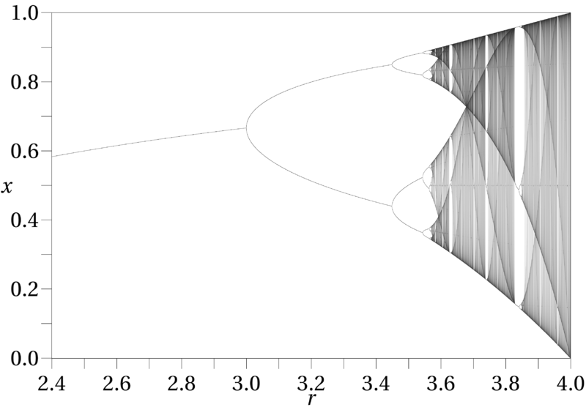
Background 2
The Logistic Bifurcation Diagram
The bifurcation diagram plots the end behaviors of different systems (i.e. the end behaviors of iterated sequences at different intrinsic rates of change) against a measure of change in the dependent variable. It shows the period doubling route to chaos and thus the structure of a chaotic system.
This diagram tells us important things that help us better understand market dynamics on a structural level (i.e. given that markets are deterministic, chaotic and nonlinear).
One such important piece of information it provides is that chaotic systems are fractal in structure, and so we can equate chaotic behavior to fractal behavior (the bifurcation diagram is self-similar, i.e. fractal). This means that an understanding of fractals and fractal behavior enables measurement and control of the fundamental dynamics of the system.
This is important because fractal behavior is less abstract in concept and can be read by the pattern of point displacement in a given system. The chaos game for instance.

Slide 4
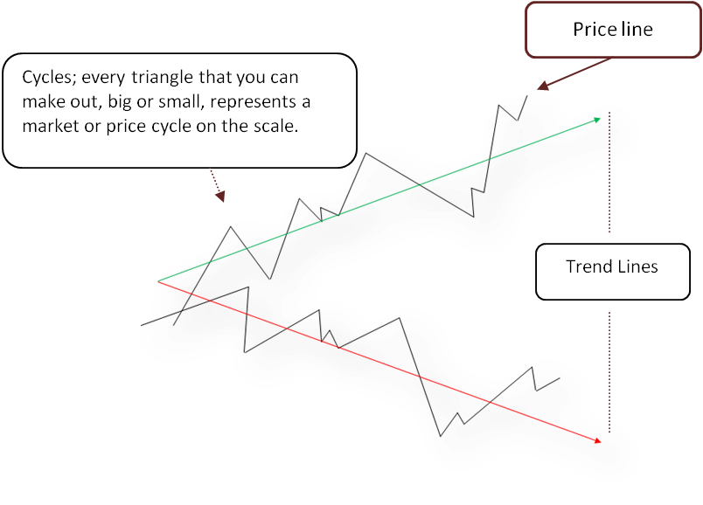
Background 3
There are several important (rational, even somewhat moral) implications arising from the knowledge that markets are nonlinear and chaotic.
One crucial implication is that a key premise on which technical analysis (TA) is based (history repeats itself) is fallacious. Another key implication is that no linear model of the market is suited to explaining price except in very partial terms (of which both so-called “fundamental” analysis (FA) and technical analysis (TA) are examples). This is because the chaotic variable (price in this case) evolves in nonlinear ways.
But even more significant is that the absence of nonlinearity in a model describing the market is problematical because chaos needs nonlinearity. Nonlinearity is really what helps to make a chaotic system meaningful because that is what constrains its dynamics to be within the limits they express and as such explain how the parts of the system relate in order to be.
In direct terms therefore, the basic reason why TA and FA remain widely employed (and the market wickedly impossible to “master” by them), is that those disciplines (and their variants in OFT and even algorithmic trading) reflect the limits of understanding generally available to market participants (with respect to the dynamical structure of markets).

Slide 5


Background 4
In order to trade a chaotic system and be consistently successful, it must be obvious to the trader what the local limits are in a global frame that suggests the largest immediate objective of the market (each trade). Without this kind of knowledge (structure) in a linearly unstable system, it becomes a gamble to action reads. The trader is simply not sure of what is going on and everything soon begins to appear random. Because the trader observes sequences in fast non-monotonic evolution, the trader requires the specialized knowledge of chaotic dynamics and a setup that militates against the confusion arising from chaotic properties of the variable price to read an emergent fractal structure per period.
Therefore, if a dynamical market system is deterministic but generally unpredictable; and if in addition it evolves by persistent cyclic trends, and is also known to have a fractal structure;
Then it is possible to prescribe an interpolative model (exceeding the criteria in “1”) that is a general model of the market and that will exploit it consistently. This means that based on the knowledge of how such a market is dynamically ordered, it is possible to read and trade such a market with a consistency of result that demonstrably outperforms the market.
As such, the market model can be shown, not just to be more effective than any predictive linear models of the same market, but to be the correct general trading model of the market.

Slide 6

Background 5
Reset the odds
The “predictability” of any chaotic system depends on (1) how much error or uncertainty we are willing to tolerate in a given forecast or future estimate of the chaotic variable (2) how accurately we are able to measure a system’s current state, and (3) Lyapunov time (a time scale reflecting the time from initial conditions to the point when a chaotic system becomes unpredictable). Therefore, these provide a basis by which to judge the “predictivity” of different approaches on a comparative scale.
The claim here is that it is possible to improve current “predictability” of markets from say 1/2 to say 1/20 in terms of 1 and 2 above, and as such, greatly clarify the empirical sense of Lyapunov time per interval in the case of 3. This model relies on applying the tenets of Fractal Geometry and Chaos theory to reading and trading markets, i.e. it directly employs real-time Fractal Analysis of markets.

Slide 7
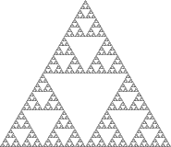
Background 6
A fractal is a never-ending pattern. Fractals are infinitely complex patterns that are self-similar processes across different scales. They are created (i.e. computer generated models of fractals) by repeating a simple process indefinitely in an ongoing feedback loop. Mathematically, any real system that describes the same kinds of functions is a fractal. We can say that fractal geometry is to chaos theory what geometry is to algebra in expressing the mathematics of chaos.

Slide 8

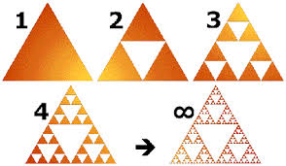
Background 7
Fractals are non-random and of non-integral dimension...
On the left is the Sierpinski Gasket (again): to generate it, we start with a triangle or the initiator as in (1). We then draw lines connecting the midpoints of the three sides and remove the resulting center triangle to gain the generator as in (2). The rules of recursion (3) simply require the generator to iterate to infinity. And so, as with all fractals, we see simplicity and recursion combine to create incredible complexity or the appearance of it.
As such, the Sierpinski Gasket is the limiting case that results when iterations of the generator (2) are continued out to infinity.
D = log N/log S
S^{D} = N
2^{D} = 3
log (2^{D} ) = log (3)
D*log (2) = log (3)
D = log (3) /log (2)
D = 1.585
The point here is that fractals are described
by precise mathematical rules and properties - and these describe fractals NOT to be random.
Where D is dimension, N the number of new pieces, and S the scaling factor.

Slide 9
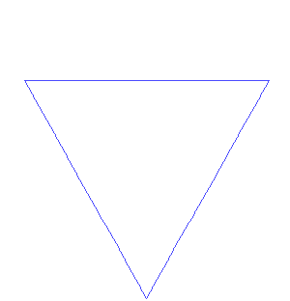
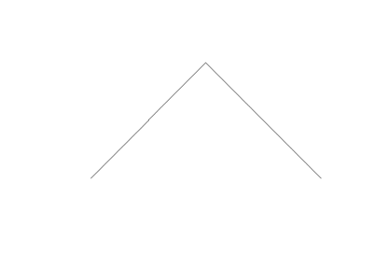
Background 8
...But fractals can model (explain the dynamics of ) things that appear random in space and or in time
A power of Fractal Geometry is the ability to model (explain) the explicit dynamics of chaotic systems. This allows two equivalent senses of deterministic chaos: (A) a system that “appears” to have “random” arrangement in space and or(B) “random” progression in time. This is extremely consequential since graphical concepts and insights tend to be much easier to grasp.
Fractals are infinitely complex (that is to say detailed). This means, fractal phenomena can be explained (modeled) to infinitesimal detail. Fractal dimension is the measure of such complexity - i.e. the ratio of the change in Scale to that in Detail (see prior slide).
The important point that is made here is that all of this analytic power allows insights into complex dynamical systems in ways not possible before the science was formalized by Benoit Mandelbrot 41 years ago.
“Fractals are supremely visual, hence supremely intuitive.” - Bonior Mandelbrot.

Slide 10
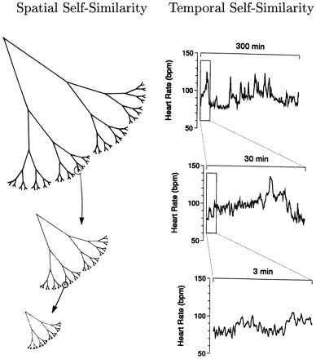

Multi-fractals - Complexity ^{x}
Background 9
Multifractals are a generalization of fractals not characterized by a single dimension. Rather, they express a continuous spectrum of dimensions reflecting complex dynamical forces in play.
Multifractals are often found in experience. Coastlines, clouds, lightning,
the human heart and electronically traded markets are examples.
Temporal Self-Similarity
Spatial Self-Similarity
So, the multifractal concept is applied not just to irregular geometric forms that lack a characteristic (single) scale of length (e.g. a coastline), but also to certain complex processes that lack a single scale of time (e.g. the human heart, traded markets).
A fractal temporal process, such as healthy heart rate regulation (Right), may generate fluctuations on different time scales that are statistically self-similar.
Irish Coastline

Slide 11
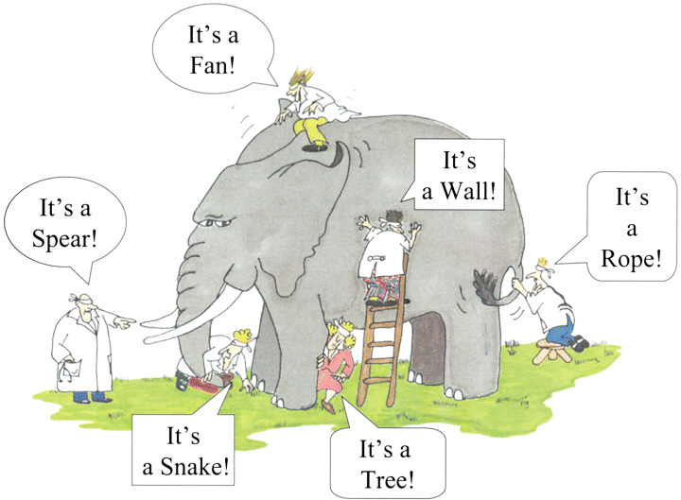
Visualizing the market as a fractal...
Rate
“Fractals should be the default, the approximation, the framework.” - Nassim Nicholas Taleb.
Time
80/20_60/40_50/50...
Frequency
...It cannot remain the story of the elephant and the blind men

Slide 12
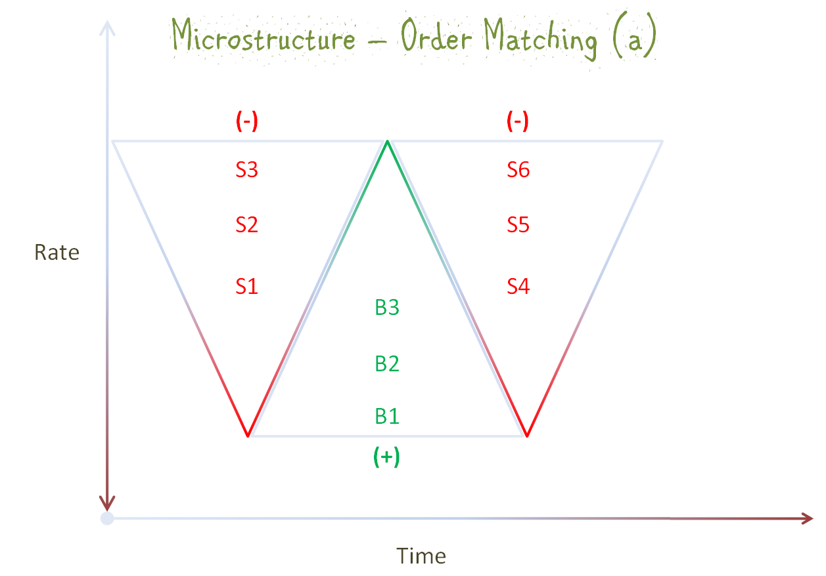
Market Microstructure
Regardless of how orders flow through (the different dialects of) an electronic trading system, in the end, there must be a matching protocol that simplifies the interface between bids and offers.
For this model, the lowest offers frontend an array of sell orders to match an array of buy orders – with the highest bids at the front end. And this applies across variable chunks of orders reaching the market between session open and close (and combining with existing orders).
In processing chunks, elements either side of the market (bids/offers) are spaced by point value (and order size) and therefore dynamically define “demand and supply schedules”. So, these are vigorously populating ranges in market time that generate many changing variables…
Notes:
In any electronically traded market, and regardless of how orders flow through the different dialects of the overall system, in the end there must be an order matching protocol that simplifies the overall interface.
Therefore, we can generalize to say that as orders reach the market place – they are matched such that the lowest offers frontend an inverted pyramid of sell orders to match a pyramid of buy orders – with the highest bids at the frontend.
When two matched arrays in range exhaust or clear, the next arrays are defined such that transactions either occur at a higher or lower price band than the immediate range, depending of course on market impetus and the availability of transactions

Slide 13
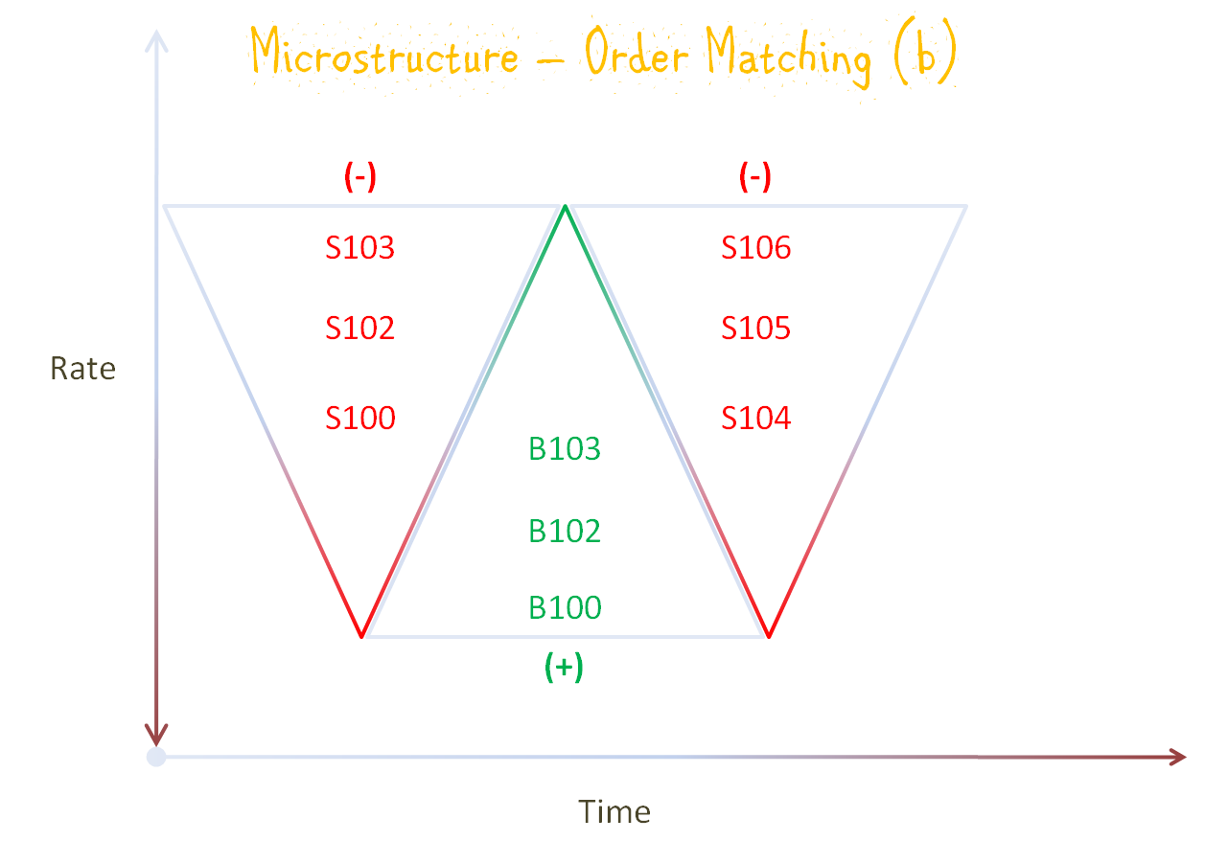
Cont’d, …and as a result, we have a myriad of sources per interval of not so obvious fluctuations defining the price curve in real-time (in addition to the more obvious one we describe further on). This state reflects something called intermittency (or aperiodic cyclicality - the signature sign of chaos).
In other words, this algorithmically driven matching engine defines an intensely unstable scheme in dynamically processing latent “demand and supply curves” in market time. Importantly (and as we show next), the output of this process per interval, is simply market clearing; which information then feeds trader reaction over the same intervals.
Clearly, not only can we visualize the movements implied, etc from this basic order matching scheme, but we can infer from this what is a pivot.

Slide 14
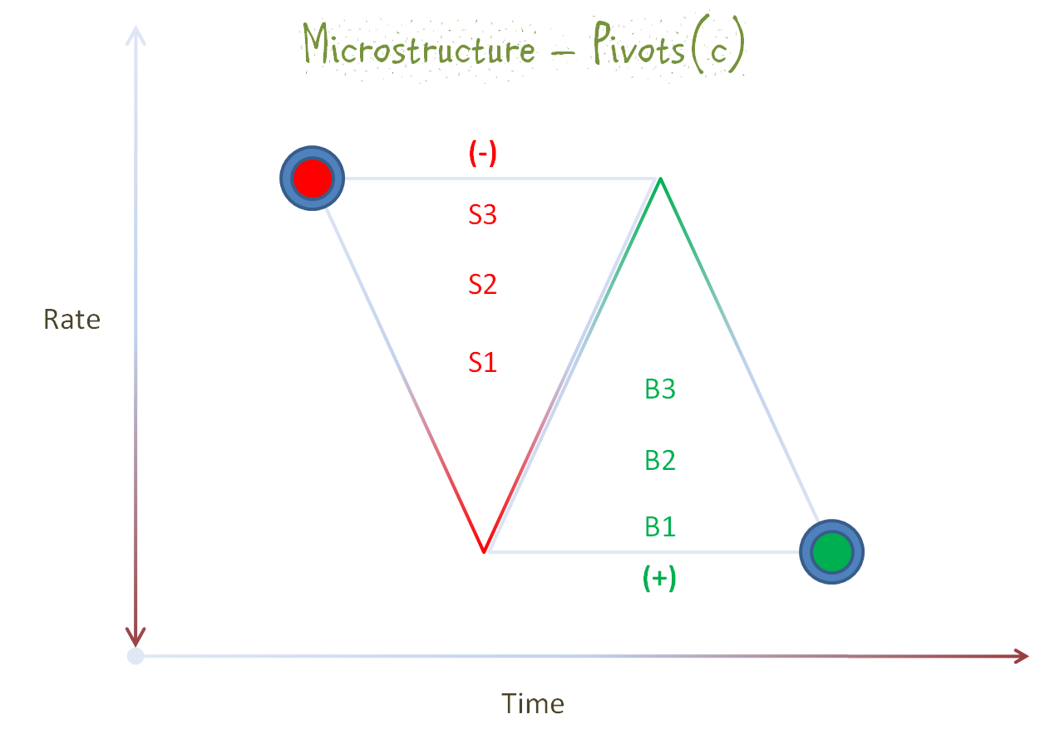
A pivot then, is that clearing price point (order book level), that exhausts two matched (oppositely signed) arrays, where there are no further matches ahead in the current interval, or in such proximity, as to sustain an initial direction.
We of course abstract from the fact that limit orders provide liquidity and market orders consume liquidity. But as long as a current range is actively populating with orders (i.e. orders are queued either side of the market), the range is not cleared and a pivot is not established to enable a reversal in such a range.
Therefore, a pivot occurs, if the market exhausts oppositely signed arrays at a price point (order book level), with “momentum” (active queue) still on one side to reach a “new” range of oppositely signed orders. As such, spot pivots pervade the entire trading space including the shortest possible interval. This system does not exhibit stable equilibrium over any term, equilibrium is everywhere unstable.
Notes:
A pivot then is that market clearing price that exhausts two matched (oppositely signed) arrays where there are no further matches ahead in the current range or in such proximity as to sustain an initial direction. This is what causes price to reverse or change direction.
As long as a transaction range is actively populating with matched orders (i.e., queued either side of the market at stable bid and offer rates), the market is not cleared and a pivot is not established to enable a reversal in such a range. But an unbalance occurs if the market clears at a price point with momentum still on one side or the other to reach a proximate field of oppositely matched or signed orders – and this defines a pivot. This is because such one sided momentum in market time is now satisfied at a price point higher or lower than the given market clearing price and over a new range
This seemingly innocuous statement is vital to understanding the overriding importance or preeminence of momentum in our formulations and modeling. It is this rate of change we seek to capture and measure in such a way that on whatever scale it occurs we are alerted early enough to the changing order implied

Slide 15
Simplicity and Recursion
Traded markets function at least 24/5 all year round (and stock exchanges for significant periods of each weekday). During this time, all that goes on (per session) in terms of microstructure dynamics (barring one or two abstractions), is what we have described, regardless of the variety of;
    Player types, order sizes and investment horizons, intentions and influences, news and market events or what have you.
    As such, all that happens in the market all of the time is buying and selling.
Therefore, the market at its most basic defines an incredibly simple form of existence:
    It admits all incoming buy/sell orders per interval;
    Matches them and;
    Signs the flow.......................... Mr. Market is mechanical (-_-).
As such, the apparent complexity of traded markets comes from the incessant and recursive but even actions of market participants across different scales, and not from any other direct measures of their humanity. This is to say, a simple pattern repeated over and over again (i.e. indefinitely) on different scales within a fixed structure --> intimates a fractal.

Slide 16
Fractal primitives defined by the math of Fractal geometry
So we deduce from ALL of this - that for price to “move” in market time, based on order flow, we need a three point structure for any aggregation of orders on any scale, large or small (the initiator).
That is to say, that there must be, for uprising price, two buy pivots and one sell pivot and for downfalling price, two sell pivots and one buy pivot to generate directed movement or flow. The Iterated Function Systems (IFS) formalism of fractal geometry would call each instance (a fractal generator).
As such, a fractal primitive (the fractal generator) in this model, simply consists of 3 consecutive range clearing price points (order book levels) in the same flow. These are price points in micro space (and therefore macro space) at each of which price reverses direction in sequence to define a price cycle. This underlying transactional framework repeating (iterated) indefinitely across all scales (the rules of recursion).

Slide 17
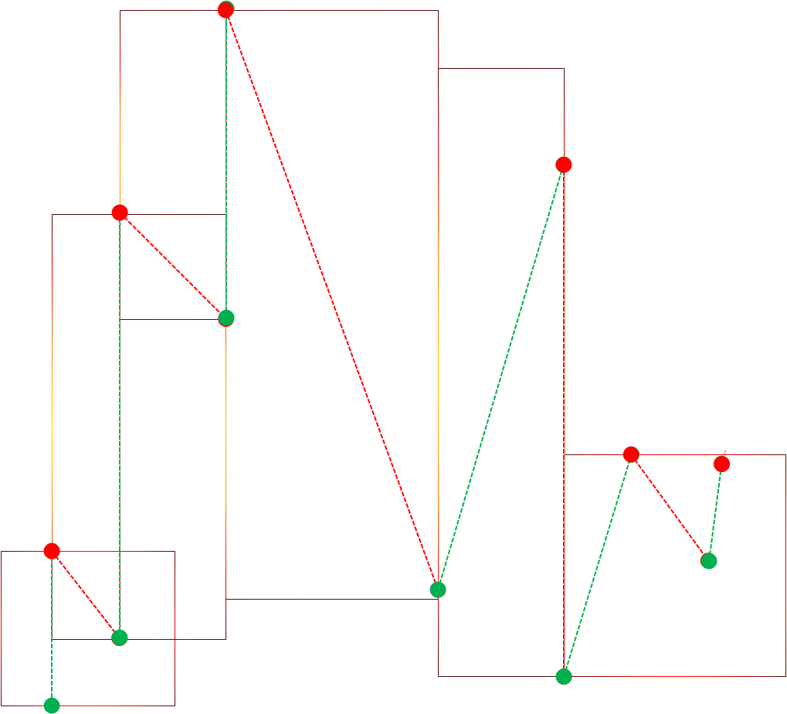
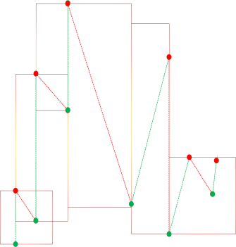

In effect, fractal primitives define as volatility shaped (self-affine) linear inequalities in market space (regardless of scale).
Therefore, primitives are the best predictors of direction immediately following in the same transaction space or flow. As linear inequalities, there can be only 6 different definitions in any flow (combining in a diverse number of ways). In other words, fractal primitives affirm the (exact) extent to which predictivity anywhere exists in market space...
The Code
Primitives as a finite set of Linear Inequalities
…fractals allow (among other things) the trader to evaluate the state of the system per interval, and therefore across time scales. The stress here being seamlessness; from market microstructure to market macrostructure, and what is more, evidence of the feedback loop in the cyclical flow of markets.

Slide 18
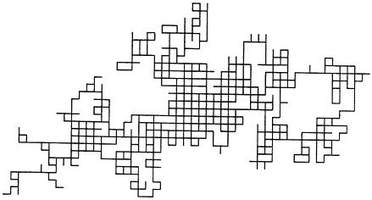
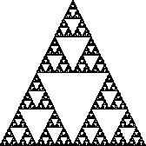
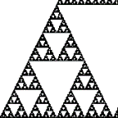
A matter of perspective: its not about the shapes of things, it is about the behaviour of numbers in the pattern of points that create the shapes.
- From micro to macrostructure
“To truly understand something, you must experience it – get it under your finger tips”-
Benoit Mandelbrot
Trend

Slide 19
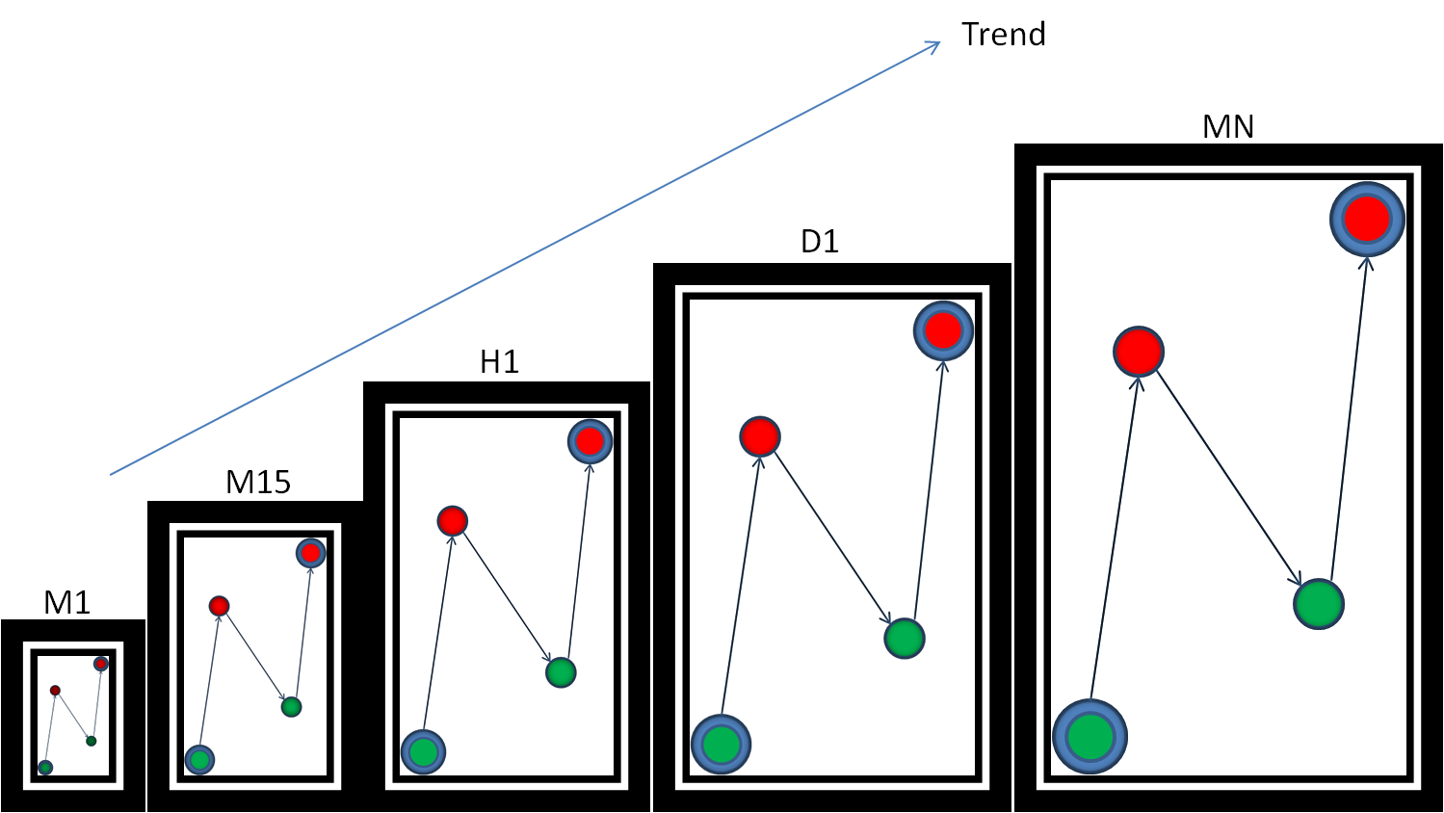
So we have that, market space is space where price fractals define aperiodic cycles across time in simple (but nested) 1,2,3 legs. From sub-minute time compression through M1 – MN and in fact at (> MN).
Fractal behaviour whether over very small or very large intervals is the same. Importantly, the smaller ones are nested in the bigger ones (i.e. Fractals nested within fractals or equivalently nested within phases of larger fractal cycles) all with the same form, and hence the deterministic( i.e. moves to only one other next state depending on the current state), dynamically scaling, Multifractal structure of markets...
2
Fractals Scale Across market space
3
1

Slide 20
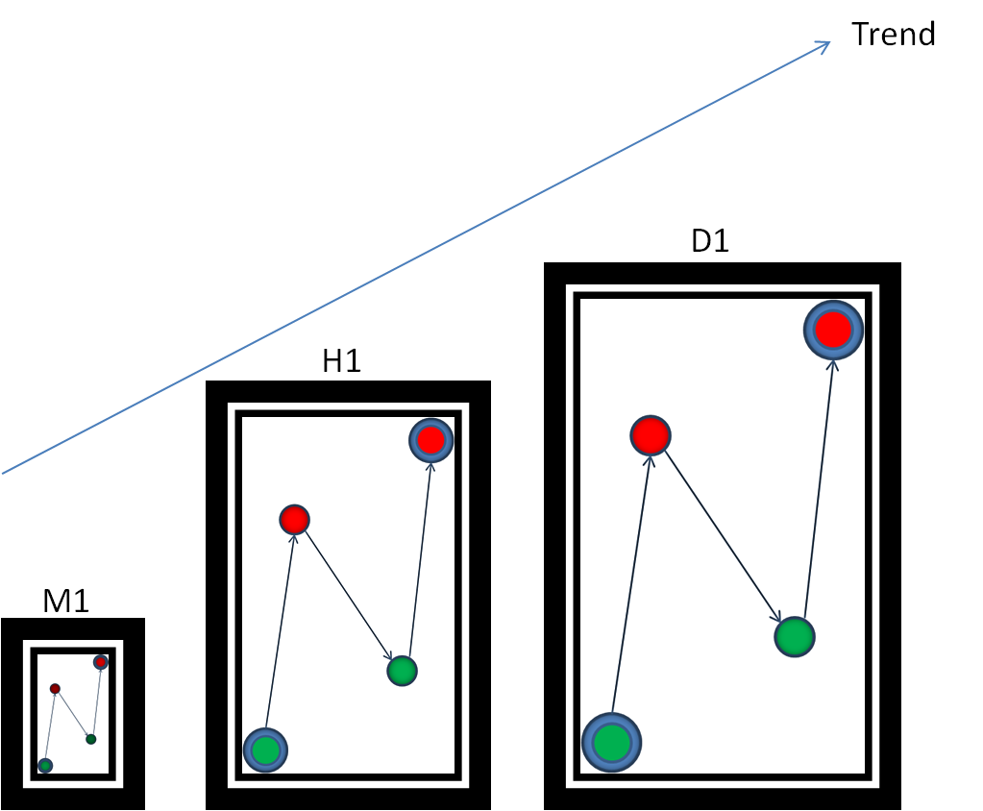
... In this simplified, primitive driven “trending” example, each cell shown is a time frame, so we have a 1-minute frame, a 1-hour frame and a 1-day frame inscribed with 1.5 cycles or oscillations in each case. We are saying that the 1-minute frame contains at least one and a half cycles of sub-minute bars just to make its 1-2 leg up and at least one and a half cycles to make its 2-3 leg down and at least one and a half more to make up the last phase or half cycle shown. Similarly, the 1-hour frame has within it sixty 1 minute bars per 1-hour bar and here contains at least one and a half cycles of 1-minute bars to make up each of the 3 phases shown.
In the same way, the 1 day bar contains 24, 1 hour bars and at least one and a half cycles of 1 hour bars to make up each of the 3 legs shown, and so on (in practice the nested (iterated) subcycle count per feeder frame could be several more to the same effect but not less than 1.5 cycles per feeder frame)...
Driving the point home ...
... Of course, this implies (as in demonstrates) that the market is a singularity (a point). It means that the market is deterministic at the margin in dynamically scaling to a single form or price point across all intervals. As such there is no sense in which price does not move as a unit at all times and what is more, the marginal move is NEVER a fair game.

Slide 21
… Everything happens (scales) in (persistent ) sequence following a fundamental order (iterated hierarchy) from left to right (until a point) and then reverts to origin (finite loop equilibrium) to resume (once again) left to right...
… this order does not change because the order expresses in the rules of recursion intrinsic to market mechanism.

Slide 22
So to cut a long story short, the fractal price structure is defined by nested (iterated), aperiodic (cyclical), price point displacement...
D
B
C
...and the market can go up or down in range, over ALL time scales in downfalling or uprising runs...
A

Slide 23
...Not the shapes, the behaviors of numbers in the pattern of points, that create the shapes...
... So yes, cycles, but not sine or cosine wave like. Instead, much rougher, aperiodic, non-monotonic, nested, infinitely scaled, i.e. fractal and therefore, illusory, when read outside of that structure, especially if focusing on a single frame at any resolution.
... Never fine lines - rough lines - fractals
spiral in and out of a nested (iterated) structure of finite loop equilibriums or “origin” (i.e. mean-reverting series), to resume scaling in direction or counter direction. Clearly, the setup is all the while driven by a nested (iterated) system of spot pivots defining fractal primitives across the entirety of market space...
B
“origins”
A
C
...In fractal geometry, we hear mathematicians say that the orbit of some seed, s is attracted to S. S being a complete mapping of all s(the complete fractal form). Sometimes S is called a strange attractor...

Slide 24
As a result, ( (-_-) and this is key) – markets do not “trend” per time frame in any useful (tradable) sense. Markets scale as a unit, i.e. price spirals out of “origin” as a unit, going from left to right, across scales (up or down in range) to a single point. At such a point, price is back in “origin,” fluctuating (i.e. spiraling out of “origin”) to resume (up or down in range) as a unit, and from a single point - making time frames entirely arbitrary.
This is knowable symmetry, as such price can be consistently timed with regard to the points in and out of any sequence of target “origins” in a given flow. Price movement is in no sense random...
... the mathematics of it’s dynamic is fixed (for all its incredible volatility). Markets are “predictable,” i.e. within the limits of fractal behaviour because electronically traded markets conform to a fundamental submission of Fractal Geometry; which is that, there is no qualitative change when the scale of a fractal object changes – a property known in mathematics as “scale invariance.”

Slide 25
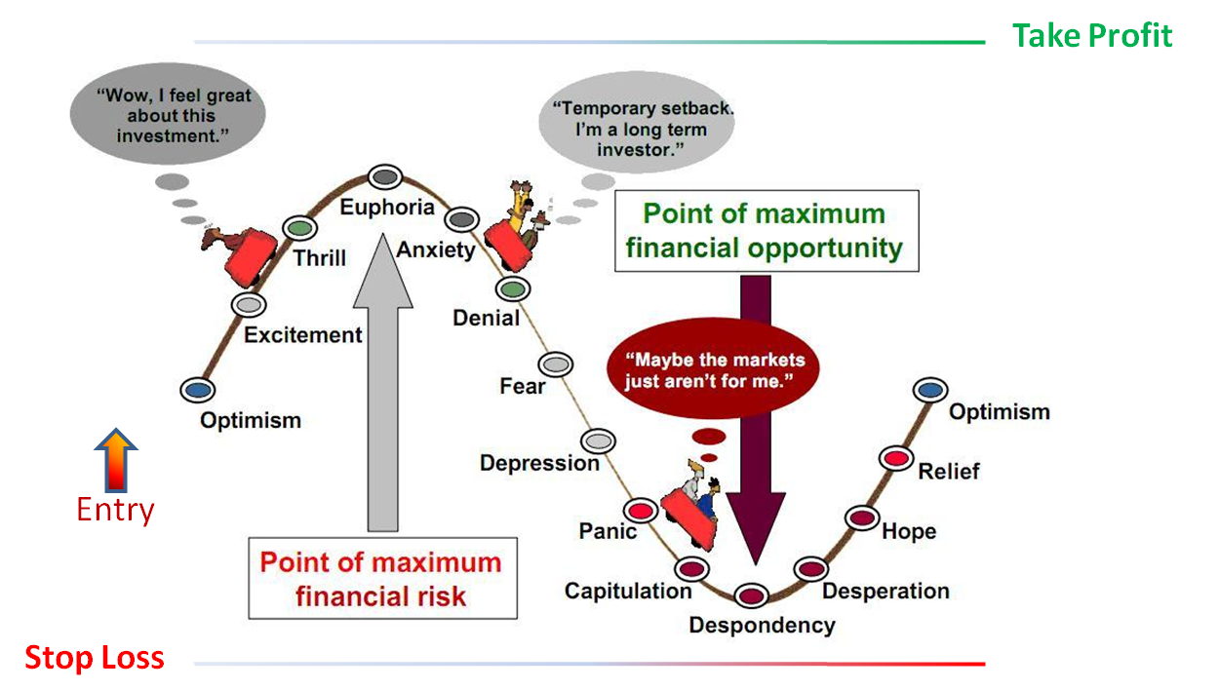
The old school 50/50 risk/reward paradigm is sourced in the idea that the market is random (with the large baggage of emotions that entails for participants).
(we just outlined why that CANNOT be!)

Slide 26
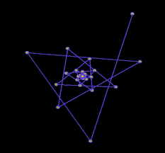

Trading the Fractal Model in event driven space
Trend is NOT your friend when the system is chaotic: consider the dynamic here where the points appear to be orbiting around and spiraling into a single point or singularity. Price dynamic is somewhat similar to these points on the Mandelbrot set attracted to a singularity. Measuring such dynamic for trend is almost meaningless and referencing a specific time frame for trade control pointless. Much of what we have described to this point is exactly reflective of this kind of dynamic.
“Fractal geometry is not just a chapter of mathematics, but one that helps Everyman to see the same world differently.” - Benoit Mandelbrot

Slide 27


Real Time Fractal Analysis - a game changer for trading.
The trading objective, therefore, is to isolate and time tradable intervals (persistent series). We do this by dynamically accounting for the iterated sequencing, proportions, magnitudes and temporal periodicity of Hurst types as they combine (from left to right) and define a “discrete” flow. Fundamentally, this is a process that “unscrambles” time (i.e., defines the dynamic outside the notion of time frames). This means, we completely do away with trend analysis, focusing entirely on the fractal dynamics presenting within a calibrated fractal trading interface. Using the IFS sense of the market, we seek to follow the market as it hops from singularized point to singularized point. There is no place for second-guessing the market by recourse to events exogenous to the scaling rules under interpretation.
But let this not sound like the trader must retain knowledge of time series analysis. Real-time fractal analysis does not imply a direct statistical analysis of a flow. Real-time fractal analysis is an integral of the application of the knowledge base on chaotic systems, the calibration of the graphical trading interface and the setup that maps the market, but most important, the interpretative skills of the trader. What is more, depending on the emergent scaling range, the same read can suffice for intraday, swing or position trade entry and control (i.e. It all depends on the emergent “prediction” horizon - i.e. the interpolative space). That says something of how simplified, the field becomes, and how more acute judgement is, in that space.

Slide 28


The order in chaos - is about timing
High volatility +
Time bound directional trades
The average trader needs only a basic understanding (as in working knowledge) of chaos theory and fractal geometry. With the calibration described, and with time “unscrambled” as it were, the entire setup becomes extremely intuitive (and highly simplified). The trader is able to directly read the dynamical sequencing of iterations (and the character of fluctuations) across scales and can therefore assess the implications for direction and range and this is mostly by visual inspection (that is to say the trader can assess the implications of fluctuations and key events across time in terms of some singularized point). What I do not seem to have conveyed and would like to stress at this point is that chaos theory is actually a Godsend for trading. It describes the behaviors of iterates across time within a defined structure depending on the intrinsic rate of change, for instance in terms of the logistic map, the logistic systems and the summary structure of the bifurcation diagram (which combined provide us a roadmap to the behavior of chaotic systems). Think about it, electronic trading platforms present us with a similar scenario all of the time and with just a little tweak we can make the connection to the recurrence relation chaos theory describes in the constructs I have mentioned.
It is this structure that multifractal analysis must account for to enable the trader time trades to near exactitude (when available). This is the great contribution of Mandelbrot and chaos theory to trading – i.e. timing.”

Slide 29
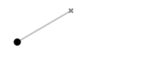
Samuel Ikwue - Monday, January 7, 2017
In conclusion: Unscramble time
From the need to study the subjects of Chaos Theory and Fractal Geometry, to the original insight as to how and why the market is fractal, through how a trading interface can be calibrated to define the multifractal structure of markets, and to the specific methodology of applying fractal analysis within such an interface, I spent 10 of my 59 years on earth working on how price actually moves, and therefore how markets must be traded. I now stand as a resource in the implementation of these ideas.
First, it is clear that the dynamic fractal structure defines market opportunities - in terms of timing and range. To be effective in such a space the trader must find a means to accurately read the local limits in the global frame that defines the largest immediate objective of the market. Among other nuances of number behavior, price is in non-monotonic evolution all of the time and the setup has to account for the flow orientation implied by the emergent fractal structure.
Second, there are at least three types of dynamics acknowledged by fractal geometry (Brownian series, Mean-reverting series and Persistent series), and that it is the iterated proportions and sequencing of each type combining in real-time “discrete” flows (i.e. movements from singularized point to singularized point), that multifractal analysis must account for, to allow the trader time tradable intervals to near exactitude and to scale (Cf. Mandelbrot’s clock time versus trading time). But third, and even more profound is that - to read those Hurst types into validity, you “unscramble” time. My (Mis) Understanding of Mandelbrot.

